Slide 1

European Federation of Statisticians in the Pharmaceutical Industry
(EFSPI)
European Federation of Statisticians in the Pharmaceutical Industry
(EFSPI)
Jan 2026

Slide 2

What is EFSPI?
EFSPI = European Federation of Statisticians in the Pharmaceutical Industry
Founded in 1992
EFSPI is an “umbrella”, non-profit making organisation
A federation of National European Groups
Now have 10 national groups
No individual members
Our national organisations collectively represent 2200 members
Each organisation has 2 members on the EFSPI Council
Website: www.efspi.org
Constitution

Slide 3











EFSPI Members
France
SFdS
Finland
SSL
Germany
APF
Denmark
DSBS
Italy
IBIG
Belgium
SBS/BVS
The
Netherlands
PSDM
United Kingdom
PSI
Sweden
FMS
Switzerland
BBS

Slide 4

EFSPI Council
Members
https://www.efspi.org/Documents/Members/Member%20Groups%202018/EFSPI%20Member%20Groups%20List%20-%20Current%20Updated%20Website.pdf
France
SFdS
Emmanuel Pham,
Pierre Mancini
Teppo Huttunen,
Anna Wiksten
Finland
SSL
Germany
APF
Christoph Gerlinger,
Vivian Lanius
Thor Schütt Svane Nielsen,
Anders Gorst-Rasmussen
Denmark
DSBS
Italy
IBIG
Andrea Nizzardo,
Luca Grassano
Stephane Munier,
Fabian Tibaldi
Belgium
SBS/BVS
The
Netherlands
PSDM
Egbert Biesheuvel,
Corine Baljé
David Wright,
Jennifer Visser-Rogers
United Kingdom
PSI
Sweden
FMS
Jonas Haggstrom,
Magnus Kjaer
Kaspar Rufibach,
Lilla Di Scala
Switzerland
BBS
info: Member groups
Jan 2026
Notes:
https://www.efspi.org/Documents/Members/Member%20Groups%202018/EFSPI%20Member%20Groups%20List%20-%20Current%20Updated%20Website.pdf

Slide 5

EFSPI Objectives
To promote professional standards of statistics and the standing of the statistical profession in the pharmaceutical industry
To offer a collective expert input on statistical matters to national and international authorities
and organisations
To exchange information on and harmonise attitudes to the practise of statistics in the European Pharma Industry and within member groups

Slide 6

EFSPI Officers and Key Roles
President –
Anna Wiksten
Vice-President –
Egbert Biesheuvel
Treasurer –
Lilla di Scala
Director (legal entity) –
Thor Schütt Svane Nielsen
Scientific Lead –
Axel Krebs-Brown
Regulatory Lead –
Fredrik Öhrn
Special Interest
Groups (SIGS) –
Emmanuel Pham
Statistical Methodology
Leaders –
Kaspar Rufibach, Mouna
Akacha, Cornelia Kunz
Statistical Leaders Chair – Christine Fletcher
Stats Regulatory Workshop –
Vivian Lanius
Communications Officer –
Andrea Nizzardo,
Luca Grassano
EFSPI Executive Office –
Claire Laveaux,
Moore Engage
EFSPI Officers

Slide 7


EFSPI Activities
Ecosystem
Statistical methodology leaders
Statistical Methodology Leaders
Scientific
& Training Academy
Ecosystem
Scientific
& Training Academy
EFSPI Council
Statistical methodology leaders in drug development
EFSPI Council
Scientific
& Training Academy
EFSPI Statistics Leaders
EFSPI
officers
EFSPI Statistics Leaders
EFSPI Council
Special Interest Groups
EFSPI
officers
Special Interest Groups
Statistical Regulatory Workshop
EFSPI Working Groups

Slide 8

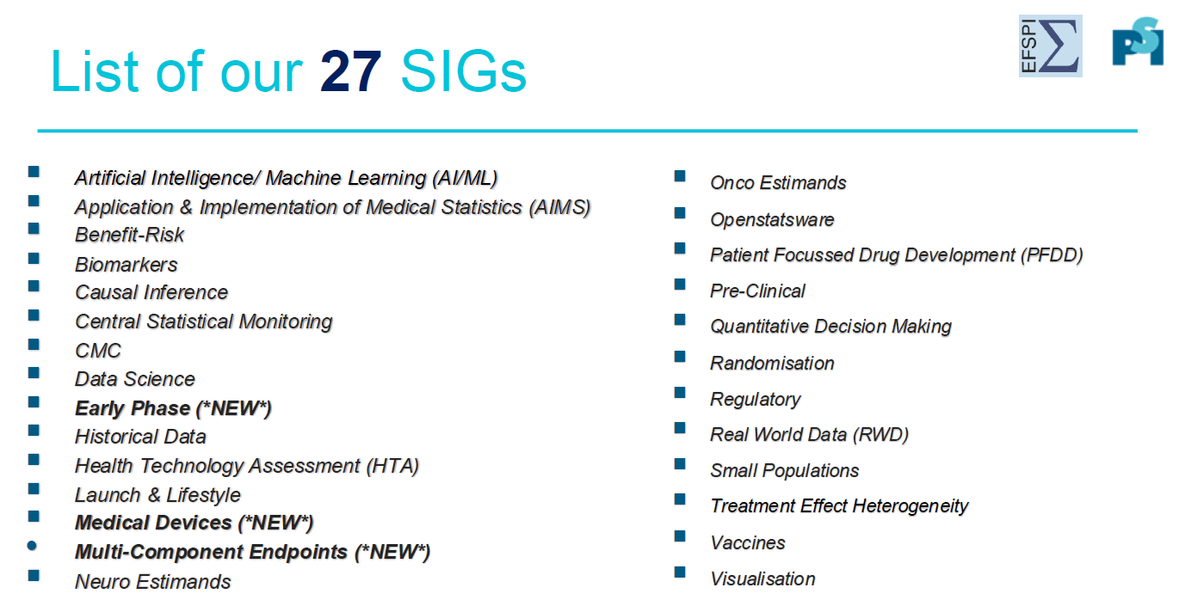
EFSPI Activities –
Current ESIGs
SIGS (psiweb.org)

Slide 9

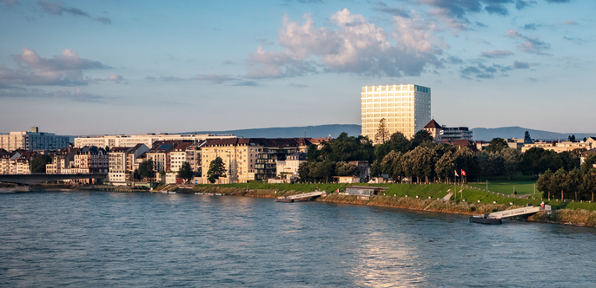
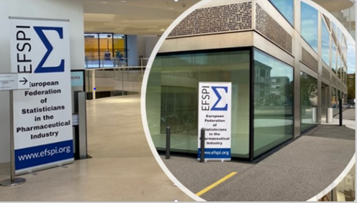
11th EFSPI Regulatory Statistical Workshop
Regulatory Workshop
  19-20
  August
Workshop with unique atmosphere of collaboration and open discussion on statistical and regulatory science in general.
Agenda is under construction by the Scientific Committee
Possible to submit a short topic for discussion with a panel of regulators
Registration fees at the same decent level (€280 / €70)
Block booking for face-to-face attendance:
starting at 8400 Euro (up to 50 participants) – see website
Block booking for unlimited virtual attendance:
2800 Euro (break-even with 40 colleagues)
https://efspieurope.github.io/workshop/2026.html

Slide 10

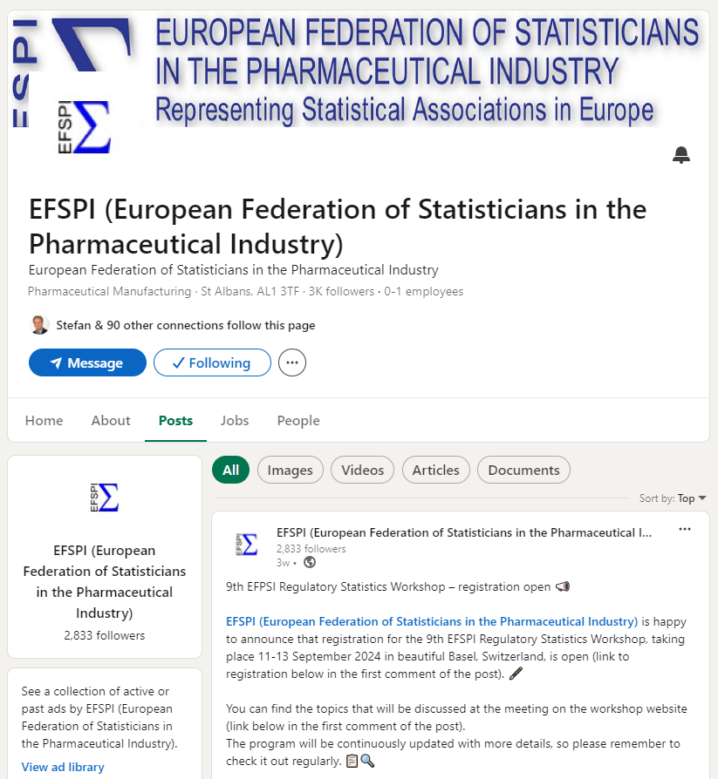
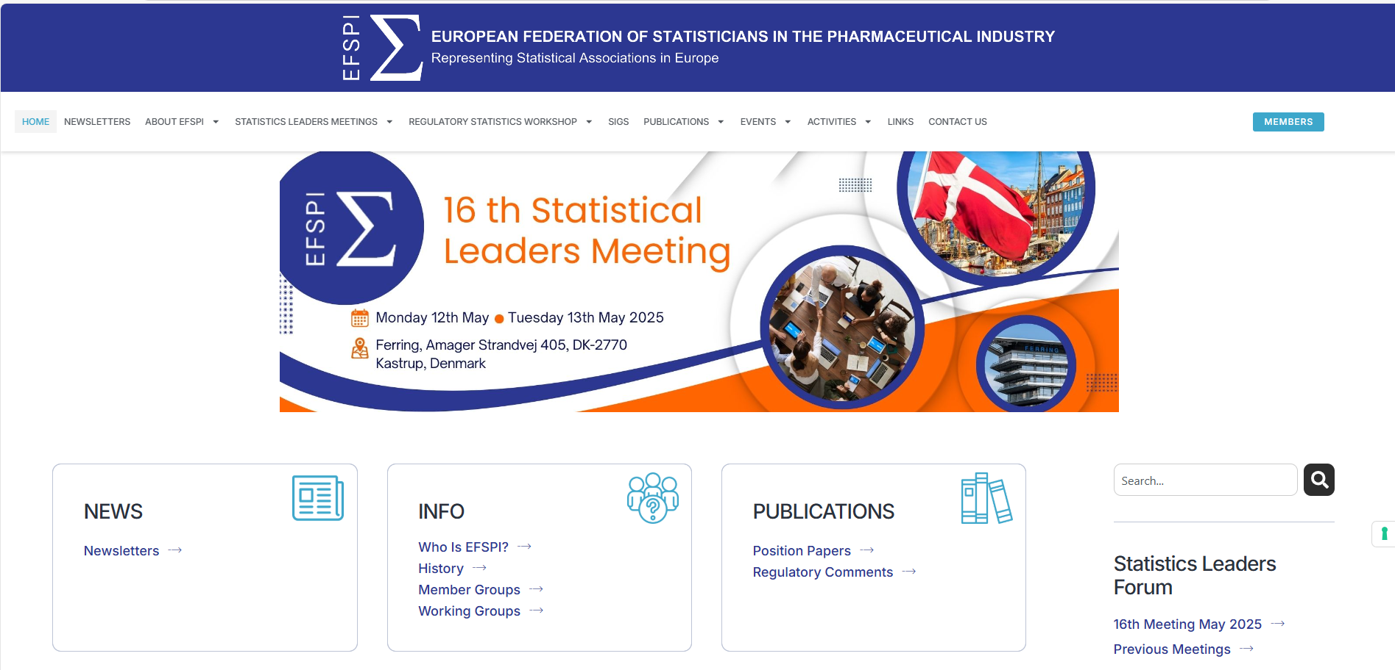
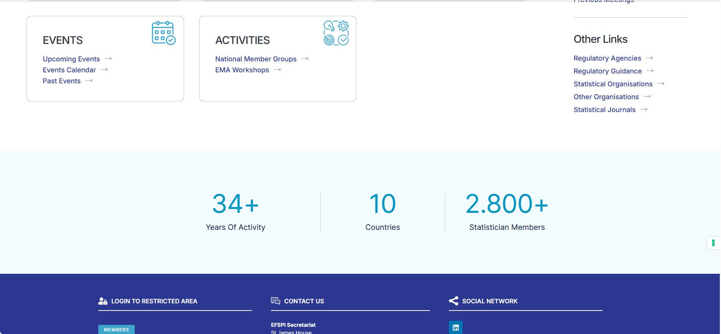

EFSPI –
Communications
www.efspi.org

