Slide 1
Longitudinal Analysis
Beyond effect size
Cheikh Diack & Nicolas Frey
M&S - Translational Research Sciences
EFSPI 13th September 2012

Slide 2
Only size (of effect) matters!
The benefit of a treatment is given by the size of its impact on clinical endpoints
baseline
EFFECT SIZE
last visit
TIME
Two time points are adequate to estimate the size of effect
The path from baseline to last visit also matters

Slide 3
Integrating the dynamic of the response
Modeling the system not the data
Can we differentiate the system parameters from the drug parameters ?
What do we do with such information?
  Predict the effect of new drugs on the system
  Long term prediction (e.g.: clinical endpoint)
  Detect sub-population and understand their behaviors?
  ...
Avastin®: relative change of tumor size from Baseline
Relative change
Time (week)

Slide 4
Predicting survival of a phase III trial from a longitudinal tumor response in phase II trial
XELODA (Capecitabine) in CRC
5-FU
Phase III
XELODA® (Capecitabine)
Phase II
  Treatment:
  Constant Cell kill rate
  Resistance apparition rate
Tumor
Model
  Treatment:
  Constant Cell kill rate
  Resistance apparition rate
Tumor
Model
XELODA® (Capecitabine)
Phase III
Tumor
∅ W6
Tumor
∅ W6
  Patients:
  Tumor growth rate
  Tumor size at baseline
?
  Patients:
  Tumor growth rate
  Tumor size at baseline
Survival
Model
Survival
Model

Slide 5
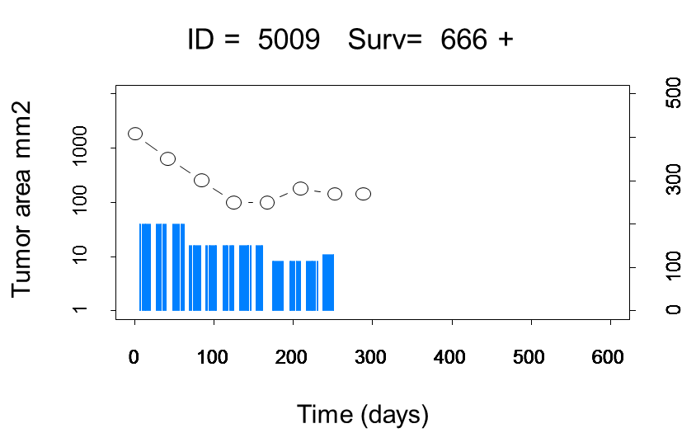
The model describes sum of tumor larger diameters in function of time and doses
The tumor is assumed to grow naturally over time with a certain rate.
The drug is assumed to affect the tumor with a constant-cell-kill rate.
The dose driving the effect is exactly the amount administered at each time. (i.e. No dose kinetic is considered in this model)
Resistance apparition is introduced by considering that the killing rate of the drug decreases exponentially with time. Resistance starts after 1^{s}t dose administration and is independent of the dose amount. Resistance is an individual specific characteristic.

Slide 6
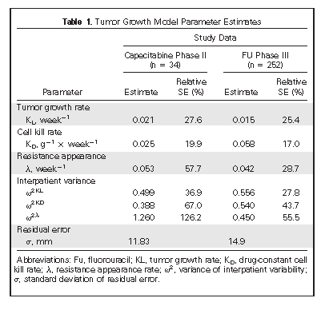
Final parameter estimates
Tumor growth rate was estimated (~1.5 times) higher in Phase 2 than Phase 3
Tumor growth rate from Phase III 5-FU was used for Capecitabine Phase III simulation

Slide 7
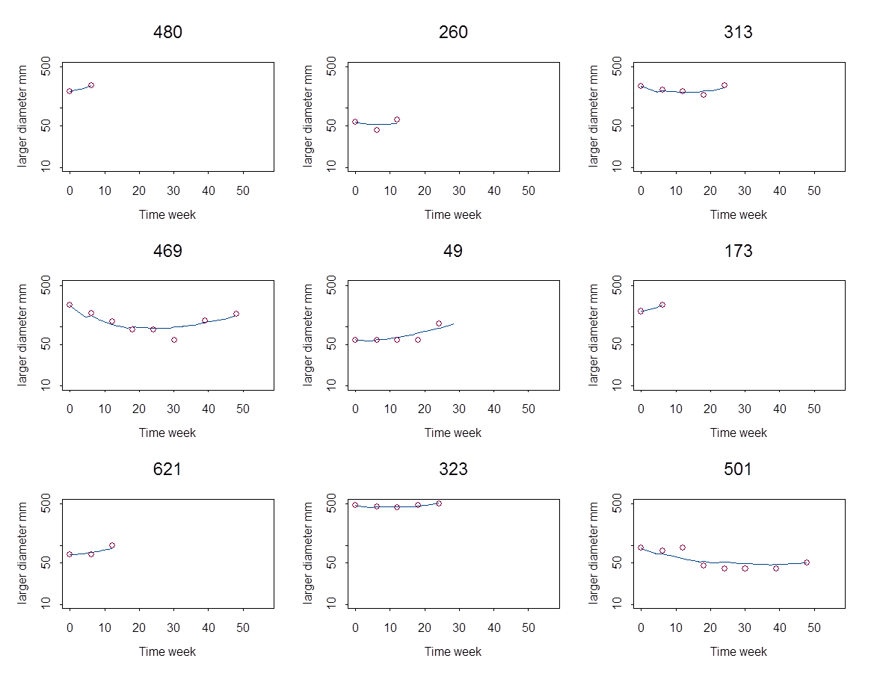
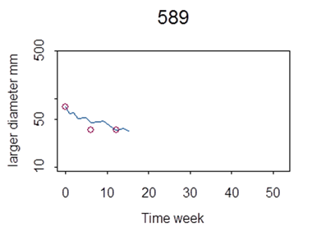
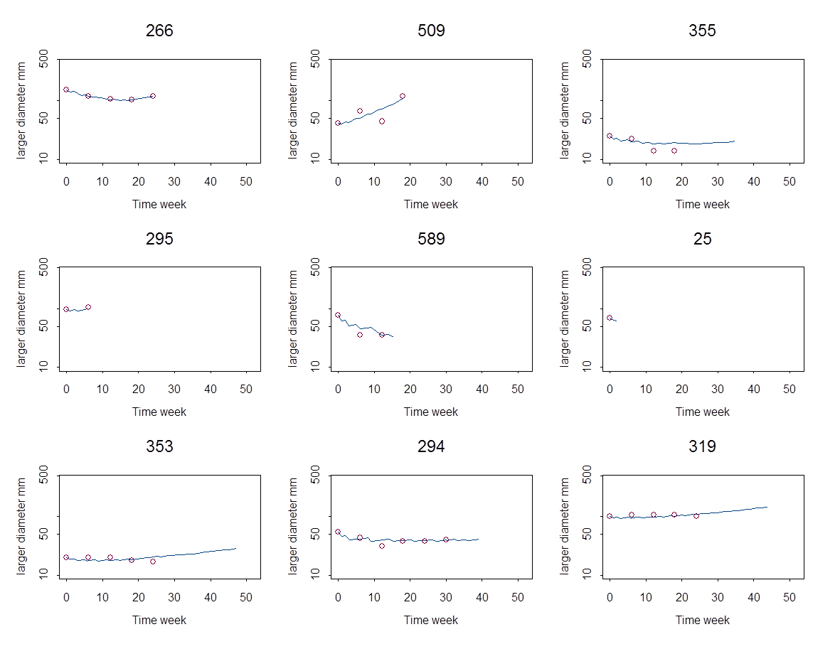
Tumor size time course: predicted vs. observed
5-FU
Capecitabine

Slide 8
Predicted tumor reduction at week 6 (5-FU)
Obs: 0.053
Pred: 0.047 (0.026-0.073)
Obs: 0.042
Pred: 0.047 (0.026-0.073)

Slide 9
CRC Survival model build on 5-FU
Parametric model assumed a lognormal distribution of survival times
Observations: 505 Total; 9 Censored

Slide 10
Predicted Survival (5-FU)
Obs: 366
Pred: 373 (337-411)
Obs: 401
Pred: 387 (349-431)

Slide 11
Predicting survival for a phase III trial
Capecitabine
Sampling for simulations:
  baseline tumor size from 5-FU patients
  dosing history of patients from Phase 2 data - drug parameter
  tumor model parameters from uncertainty and inter-individual variability:
    Constant cell kill rate from Phase 2 parameters - drug parameter
    resistance rate were drawn from Phase 2 parameters - drug parameter
    Tumor growth rate from 5-FU studies
  survival model parameters from uncertainty

Slide 12
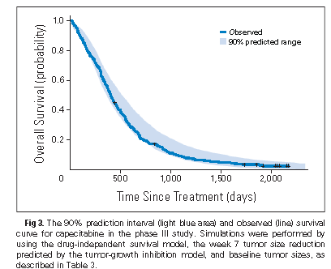
Predicted Survival (Capecitabine)

Slide 13
Summary
The dose-tumor size-survival model was qualified to predict 5-FU survival. Capecitabine Phase III survival were predicted from Phase II tumor measure.
Further work has shown that the structure of the tumor size model is robust in at least two tumor types (BC and CRC)
This approach may be useful tool for decision making

Slide 14
Overall conclusion
The characterization of the system parameters may allow to extrapolate from short term to long term effect
Similar mechanistic approaches work in other disease areas such as Diabetes and HCV
There are different techniques from empirical to more mechanistic approaches for the analysis of longitudinal of data
More synergy between Biostatistics and M&S is needed to improve the quantitative support to drug development

Slide 15
Acknowledgements
Valerie Cosson
Franziska Schaedeli
Ronald Gieschke
And… many others
Tumor size

Slide 16

We Innovate Healthcare

Slide 17
Predict “SO14796” from SO14695 Data The model survival predictions (n=301 patients)
New Data

Slide 18
What is the process leading to the observed response?
baseline
EFFECT SIZE
last visit
Are we here?
Are we here?
TIME
The path from baseline to last visit also matters

Slide 19
A dose-tumor-survival model for advanced and/or metastatic colorectal cancer (CRC) treated by Capecitabine and 5-FU
To predict survival and difference in Phase 3 Capecitabine versus 5-FU
Data
  Capecitabine from one Phase II SO14797 (35 pts)
  5-FU arm data from two Phase III SO14695 (304 pts) and SO14796 (301 pts)
  Capecitabine arm from the two Phase III studies was only released when the predictions were in
Models
  Tumor size model for Capecitabine developed from Phase 2 data
  Tumor size model for 5-FU developed from Phase 3 data
  Survival model developed from 5-FU Phase 3 Data

Slide 20
Difference between arms across the 1000 replicates
Survival difference between arms is difficult to show with 604 patients per arm

Slide 21
Predicted survival
All studies (604 patients per arm)

