Slide 1


Simplicity, Complexity and Modelling
Stephen Senn
Notes:
There is increased apparent enthusiasm for modelling in clinical trials.
This is particularly apparent in early phase trials but there are also some signs of a greater willingness to be more adventurous in analysing phase III trials. The modelling in question covers the relationship between outcome variables and predictor variables, including, of course, assigned treatment and sometimes elaborate schemes for preserving type I error rates. However, there are two respects in which we could do much better and are failing to do so. One is in the definition of primary outcome variables and the other is the more intelligent use of predictor variables. In fact there are examples going back over decades in which the obsession with apparent simplicity combined with an enthusiasm for new techniques produces absurd combinations.
For instance, when the general estimating equation methodology of Liang and Zeger was introduced in the mid 1980s it was rapidly enthusiastically embraced in the regulatory context as a practical solution to handling repeated binary data. (I speculate that a possible explanation was that there was an influx of statisticians in the 1990s to the FDA with freshly minted PhDs, some of them from Johns Hopkins, who just liked what they were used to.) In many cases, however, the data in question were simply arbitrary dichotomisations and it was only the wasteful and arbitrary division of patients into two which made the use of a standard mixed model impossible.
As regards the mixed model itself, however, this is a very fine and flexible tool but in many cases it gives scarcely any increase in precision compared to the summary measures approach. The main benefit in gain is precision is not in using the more complex compared to the simpler approach but in defining the appropriate measure of treatment effect and in choosing and using prognostic covariates effectively.
Another example is increasingly sophisticated methods for dealing with ordinal data. However, in many cases, the presumed ordinality is very late on the scene. Consider the example of a change score in the Beck depression inventory. The score is a sum of 21 items and thus involves 20 linear operations, to which a 21st is added by taking change from baseline. To say at this stage that it cannot be treated parametrically is absurd.
I claim that being consistent in our approach to clinical trials and applying the same sophistication to thinking about outcomes and predictors that we do to choosing the 'statistical model' would yield huge benefits in efficiency. It is nothing short of a scandal that we continue to use, and that regulators continue to promote, so-called 'responder analyses'. I propose that every pharmaceutical company should require that the power analysis for a clinical trial in which a responder analysis is proposed should be done using the continuous outcome also and the medical advisor and the statistician should then be asked to explain in detail why they propose to spend millions more than is necessary.

Slide 2
Basic Thesis
There is an increased enthusiasm for modelling in the pharmaceutical industry
A great deal of interesting work is being done
However many simple things that we have known about for decades are not being done
It is time we changed this

Slide 3
Examples
Improvements
Continued bad practice
Mixed models replacing summary measures
Better approaches to missing data
More use of non-linear models
Obsession with the log rank test
Change from baseline
  Percentage change from baseline
Dichotomisation
  Responder analysis
Ordinal measures treated as categorical
Fear of linearity
Failure to implement decision analysis

Slide 4
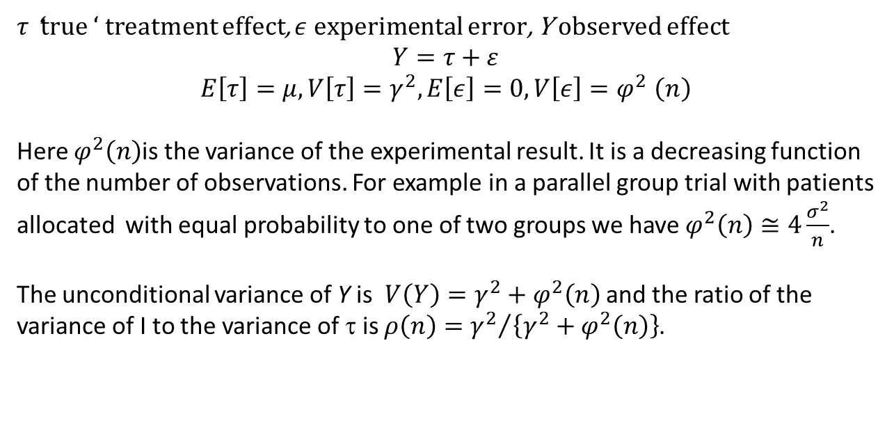
Information and Inference 1
A Simple Model
$τ$‘true ‘ treatment effect, $ε$ experimental error, Y observed effect
$$Y=τ+ε$$
$$E\left[τ\right]=μ, V\left[τ\right]=γ^{2}, E\left[ε\right]=0, V\left[ε\right]{=φ}^{2}\left(n\right)$$
Here $φ^{2}\left(n\right)$is the variance of the experimental result. It is a decreasing function of the number of observations. For example in a parallel group trial with patients allocated with equal probability to one of two groups we have $φ^{2}\left(n\right)≅4\frac{σ^{2}}{n}$.
The unconditional variance of Y is $V\left(Y\right)=γ^{2}+φ^{2}\left(n\right)$ and the ratio of the variance of I to the variance of τ is $ρ\left(n\right)={γ^{2}}/{\left\{γ^{2}+φ^{2}\left(n\right)\right\}}$.

Slide 5
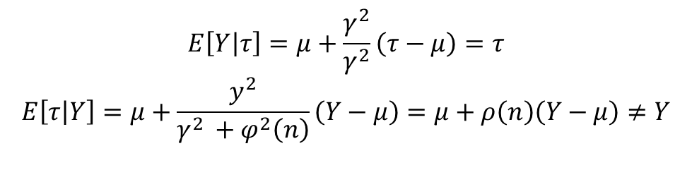
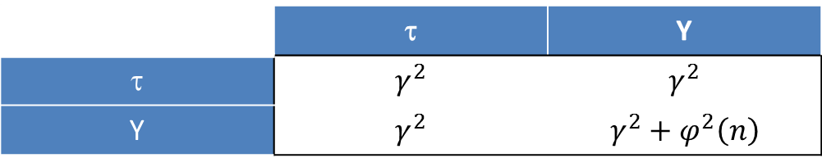
Information and Inference 2
A Simple Model
 | τ | Y
τ | $$γ^{2}$$ | $$γ^{2}$$
Y | $$γ^{2}$$ | $$γ^{2}+φ^{2}\left(n\right)$$
$$E\left[Y\left|τ\right.\right]=μ+\frac{γ^{2}}{γ^{2}}\left(τ−μ\right)=τ$$
$$E\left[τ\left|Y\right.\right]=μ+\frac{y^{2}}{γ^{2 }+φ^{2}\left(n\right)}\left(Y−μ\right)=μ+ρ\left(n\right)\left(Y−μ\right)≠Y$$
To put it another way, it does not follow from the fact that Y is an unbiased estimate of τ that on average $τ=Y$

Slide 6
Simulation
(An Aside)
In performing simulations be very careful!
Simulations (generally) run forward from model to data
But inference runs backward from data to model
Are you sure you know the difference?
Are you sure that your simulation is relevant?

Slide 7
Consequences
Expect to be disappointed
  Senn’s law ‘you can expect to be disappointed even if you have taken account of Senn’s law’
The less information you gather the more disappointed you will be
Reducing the cost of the information you have to gather is much more valuable than reducing the amount of information you need to gather

Slide 8
Flexible Designs
Good
Bad
Flexibility per se is always valuable
Killing what is useless is good
  Treatments
  Doses
  Measures?
Can lead to less information on treatments eventually chosen
What optimises power for a controlled type I error rate is bad for many other criteria
Can lead to unnatural weighting of information

Slide 9
How to do better for free
Use original values rather than dichotomies
Make more use of covariates
Study past trials to find out what works and what doesn’t
Build planning data-bases
Be sensible about dose-response

Slide 10
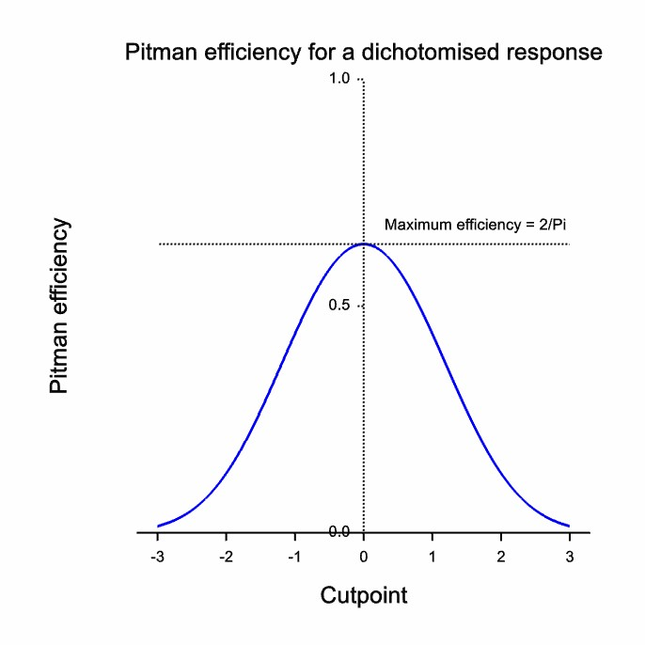

Slide 11
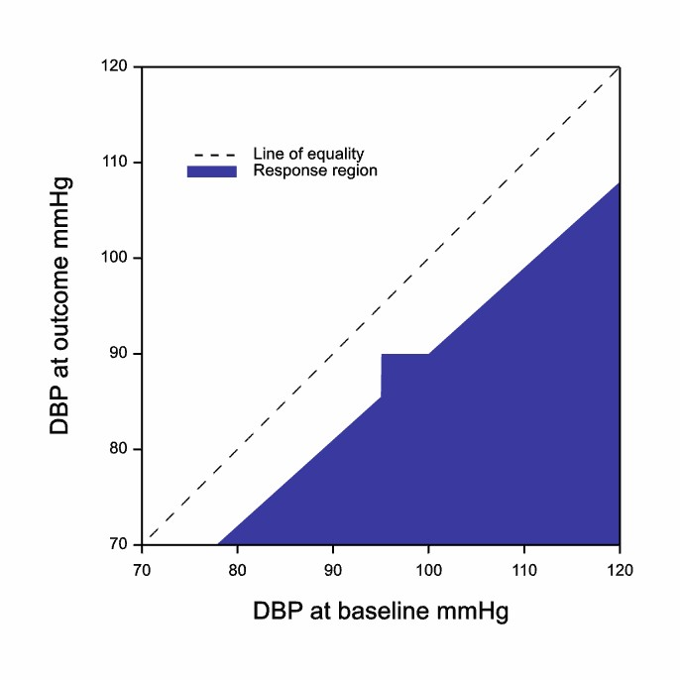
A common definition of response in hypertension
Y = outcome,
X = baseline
If (Y < 90 ∩ X > 95) ∪
(Y < 0.9X) patient ‘responds

Slide 12
A Thought Experiment
Imagine a cross-over trial in hypertension
Patients randomised to receive ACE II inhibitor or placebo in random order
Then we do it again
Each patient does the cross-over twice
We can compare each patient’s response under ACE II to placebo twice

Slide 13
Design
 | First Cross-over |  | Second Cross-over
 | Period
Sequence | 1 | 2 | 3 | 4
I | A | B | A | B
II | B | A | B | A
III | A | B | B | A
IV | B | A | A | B

Slide 14
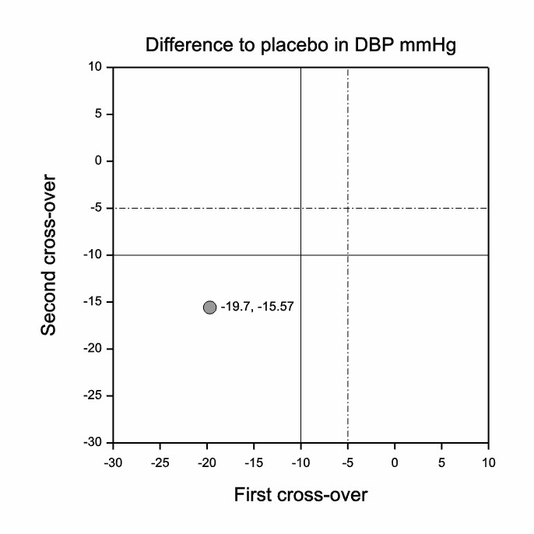

Slide 15
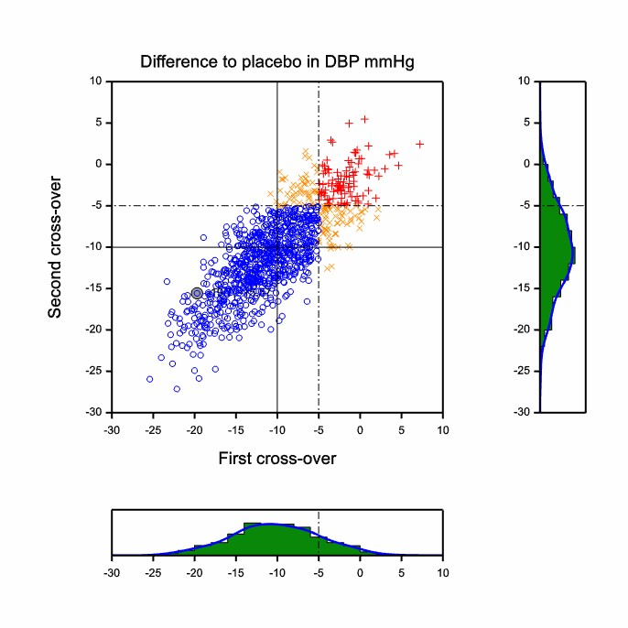

Slide 16
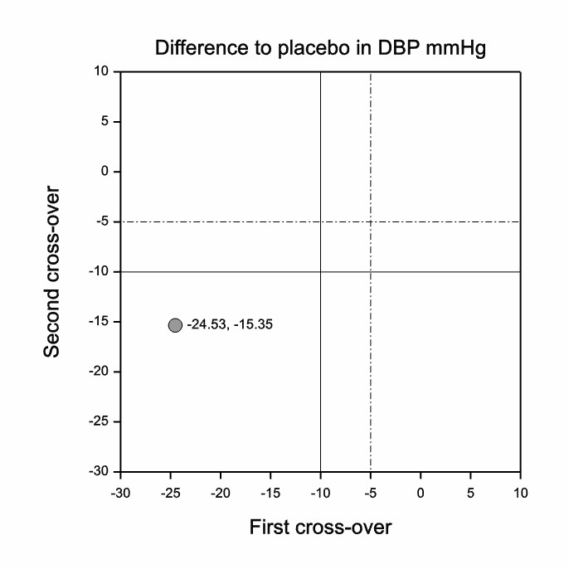

Slide 17
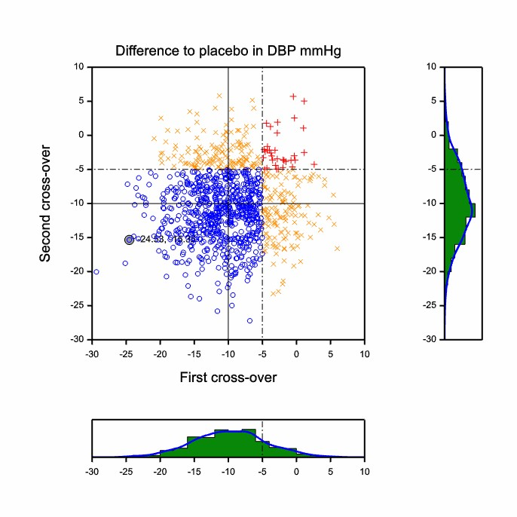

Slide 18
Tiotropium v Placebo in Chronic Obstructive Pulmonary Disease
From the UPLIFT Study, NEJM, 2008
Significant differences in favor of tiotropium were observed at all time points for the mean absolute change in the SGRQ total score (ranging from 2.3
to 3.3 units, P<0.001), although the differences on average were below what is considered to have clinical significance (Fig. 2D). The overall mean
between-group difference in the SGRQ total score at any time point was 2.7 (95% confidence interval [CI], 2.0 to 3.3) in favor of tiotropium
(P<0.001). A higher proportion of patients in the tiotropium group than in the placebo group had an improvement of 4 units or more in the SGRQ
total scores from baseline at 1 year (49% vs. 41%), 2 years (48% vs. 39%), 3 years (46% vs. 37%), and 4 years (45% vs. 36%) (P<0.001 for all comparisons).
(My emphasis)
Notes:
The SGRQ is the St George’s Respiratory Questionnaire
http://www.healthstatus.sgul.ac.uk/
“This questionnaire has 50 items with 76 weighted responses. It has good discriminative and evaluative properties and is responsive to therapeutic trials. It was developed and validated in both asthma and COPD, although it has also been validated for use in bronchiectasis and has been applied to patients with sarcoidosis. There is a large literature concerning the use of the questionnaire in many settings, including normal values. It takes 8-15 minutes to complete and is best scored using a computer. (Further information is provided on the downloads page.) The SGRQ is best thought of as a research or audit tool.”

Slide 19
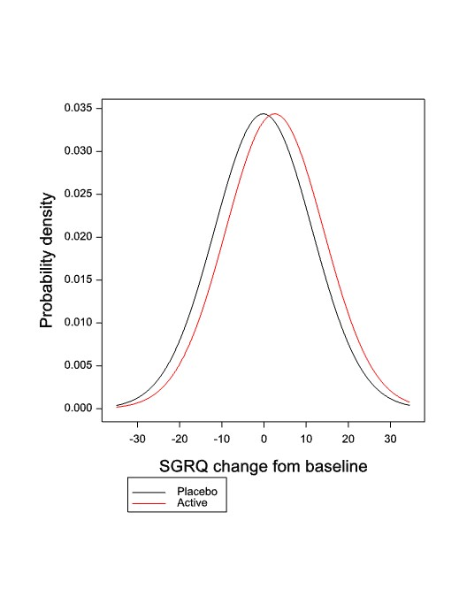

Slide 20
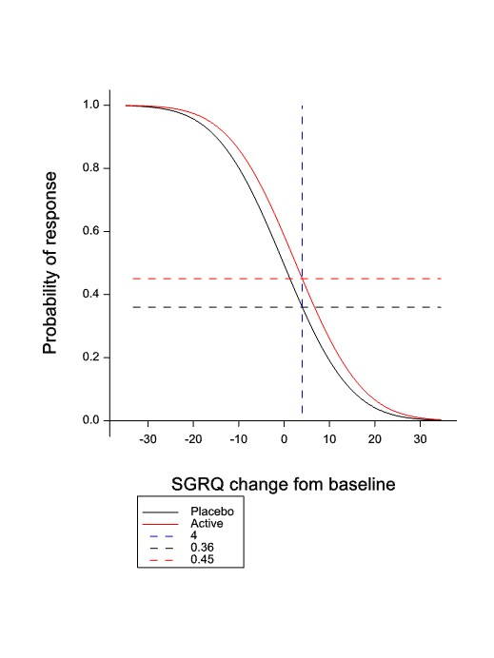

Slide 21
In summary…this is rather silly
If there is sufficient measurement error even if the true improvement is identically 2.7, some will show an ‘improvement’ of 4
The conclusion that there is a higher proportion of true responders by the standard of 4 points under treatment than under placebo is quite unwarranted
So what is the point of analysing ‘responders’?

Slide 22
Who are the authors?
1. Tashkin, DP, Celli, B, Senn, S, Burkhart, D, Kesten, S, Menjoge, S, Decramer, M. A 4-Year Trial of Tiotropium in Chronic Obstructive Pulmonary Disease, N Engl J Med 2008.
Personal note. I am proud to have been involved in this important study and have nothing but respect for my collaborators. The fact that, despite the fact that two of us are statisticians, we have ended up publishing something like this shows how deeply ingrained the practice of responder analysis is in medical research. We must do something to change this.

Slide 23
The “Wisdom” of the CHMP
It is recommended to define responders, for an assessment of proportions of patients with a clinical relevant reduction in pain score. Subjects with a 30% to 50% reduction in assessment scale as compared to baseline are considered responders. The between treatment groups comparison of responder rates is recommended as primary end-point of the confirmatory studies. (My italics.)

Slide 24
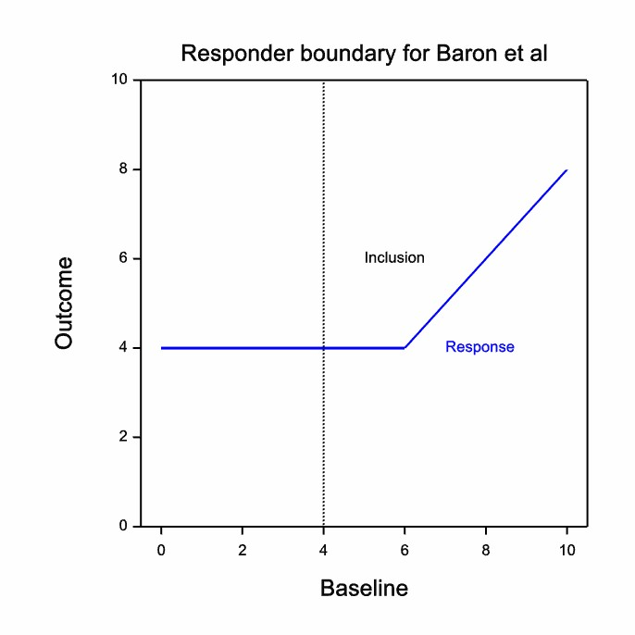
An Example of What I Mean
Baron R, Mayoral V, Leijon G, Binder A, Steigerwald I, Serpell M. (2009)
The study was a two-stage adaptive, randomized, controlled, open-label, multicentre trial .
The pre-planned primary study end-point was the rate of treatment responders, defined as completing patients experiencing a reduction from baseline of >= 2 points or an absolute value of <= 4 points on the 11-item numerical rating scale of recalled average pain intensity over the last 3 days (NRS-3), after 4 weeks of treatment.
Notes:
Baron R, Mayoral V, Leijon G, Binder A, Steigerwald I, Serpell M.
Efficacy and Safety of 5% Lidocaine (Lignocaine) Medicated Plaster in
Comparison with Pregabalin in Patients with Postherpetic Neuralgia and Diabetic Polyneuropathy Interim Analysis from an Open-Label, Two-Stage Adaptive, Randomized, Controlled Trial. Clinical Drug Investigation 2009; 29: 231-241.

Slide 25
Statements I Hate
‘Because the hazard might not be proportional we will use the log rank test’
‘Change from baseline is more relevant clinically’
‘We can’t use ANCOVA because there might be a baseline by treatment interaction’
‘Physicians find responder analyses easier to understand’

Slide 26
In Summary
There are many new complex things we can do to improve efficiency of clinical trials
  These things have required theoretical and computational advances
  They are either relatively new or it is relatively new that we have software to make them easy
However, there are many simple things we could do which would bring an even bigger dividend

Slide 27
A Modest Proposal
Every time a medical advisor proposes to have a simple responder analysis based on a dichotomy as the primary approach two sample size calculations should be done
  One using the dichotomy
  The other using the continuous outcome and including prognostic covariates
The medical advisor should then be required to write an essay justifying the extra cost of his or her preferred approach

