Slide 1
Analytical Strategy, Data Credibility, and Rigor of Science
Omar Dabbous, MD, MPH

Slide 2
Objectives
Understand current payer challenges
Importance of data rigor and credibility
Analytics strategy development

Slide 3
Evolution of Healthcare Decision Making
Regulators
Payers
Patients/Society
Clinical
Efficacy
Safety
Economic
Cost of Illness
Resource Use
Cost-effectiveness
Budget Impact
Humanistic
HRQoL
Patient Satisfaction
Preferences
Productivity
1970-80’s 1990-00’s 2010-20’s

Slide 4

Payer Questions
Do patients really benefit from the treatments they receive?
Can we afford it?
Are we getting the best value for the health care money spent?
Of the alternatives available, what treatments work best for patients?

Slide 5
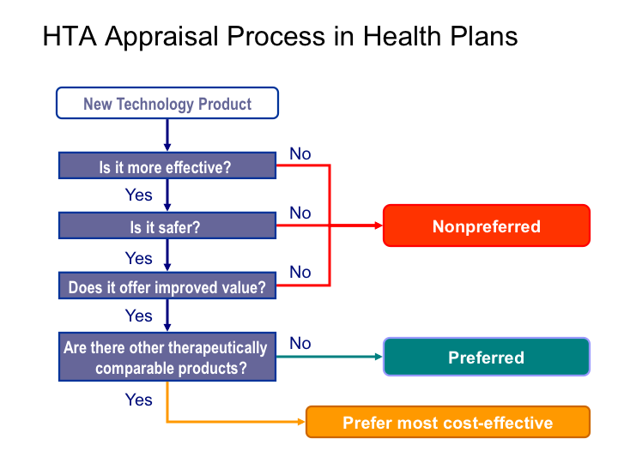
HTA Appraisal Process

Slide 6
Types of Healthcare systems
EU
  Single payer
  Reference Pricing
USA
  Fragmented Payer environment
    HMO’s
    CMS (Medicare/Medicaid)
    VA
    ACO’s

Slide 7
Accountable Care Organization (ACO)
Accountable Care Organizations as a new model for care delivery is yet another attempt in the reform process and a step towards transforming the healthcare industry - from the traditional fee for service-based care to care that creates value for patients.
Accountable Care Organizations (ACOs) are described as “provider groups that accept Responsibility for the cost and quality of care delivered to a specific population of patients cared for by the groups’ clinicians.” ACOs are bringing broad appeal and hope for the future by improving the coordination and quality of care to patients while reducing the rate of increase in health care costs over time-
  Shortell, etal. 2010

Slide 8
Credibility – Robust evidence

Slide 9
Payer and HTA Dossier
Burden of illness
Pricing
and
Reimbursement
Clinical / PROs
Unmet Needs
Cost Models

Slide 10
Scientifically robust Value Proposition
A Value story is developed bringing together clinical benefits of an intervention and communicating their impact:
    Relative efficacy, tolerability, administration benefits
    Humanistic and cost perspective
Price and value proposition are inexplicably linked

Slide 11
Value-based Pricing (evidence-based pricing)
Value-based price
$
Quality of Care
Quality of Life
Loss of opportunities
Cost offsets
Safety
Efficacy
$1
$
Comparator price

Slide 12
Current situation
Payers are scrutinising company scientific data (both clinical and HEOR) more than ever.
In many cases payers are finding holes considering the real unmet needs that medicines are proposed to fill:
  Issues with the trial:
    Statistical powering to show needed reimbursement endpoints
    Selecting the right comparator
    Selecting the right measures/outcomes
  Data from Patient subgroups is usually limited/inadequate:
    Hardly ever pre-specified for analyses (ad-hoc & not powered)
    Patients with particular comorbidities are often excluded
    Not generalizable to real world settings

Slide 13
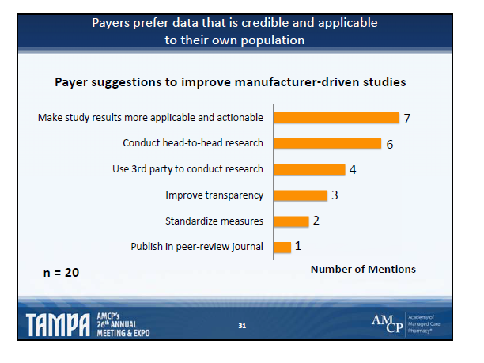

Slide 14
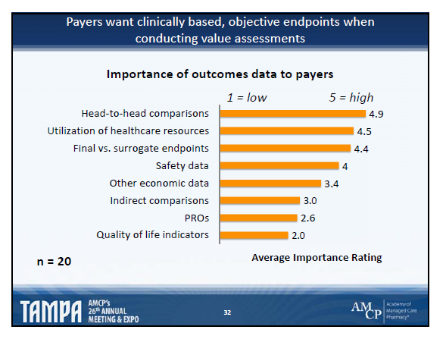

Slide 15
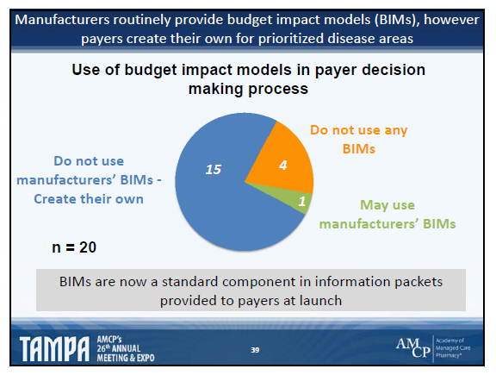

Slide 16
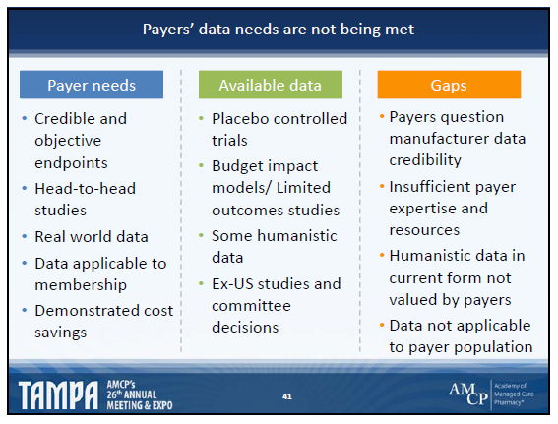

Slide 17
Expectations: Innovation and sophistication in value research design, analysis, and interpretation
Quantitative input into plans, objectives, and projects
Do we have the right evidence?
Are we asking the right questions and capturing the right data?
Are we accurately interpreting and communicating the data in a timely fashion?
Are we using the right study design and sophisticated analytical methodologies as appropriate?
Rigor of analytics and data: new insights to interpret data and to support acceptable/relevant payer and HTA evidence
Anticipate and innovatively address research questions.
Explore “what is missing”
Develop and use innovative, validated and accepted methodologies: economics, network meta-analysis, observational studies, etc.

Slide 18
Pharmaceutical Capability Gap
Significant capability gaps in key specialist skill areas
  CT aggregation, interrogation, evaluation, e.g., pt sub-groups
  Observational study design, analysis, reporting
  Healthcare Database interrogation
  Economic model building, evaluation, validation
  Network meta-analysis
  CER, HTA
  Interpretation of data outputs
  Validation of value/payer dossiers

Slide 19
Guidelines for Quality – Observational Studies
GRACE principles for observational studies of comparative effectiveness. Am J Man Care 2010;16(6):21-24
– ENcEPP Checklist for methodologic studies, 2010. www.encepp.eu
– ISPOR Good Research Practices for CER I, II, III . Value in Health
2009; 1044-1072
– GPP: Guidelines for good pharmacoepidemiology practices
Pharmacoepidemiology & Drug Safety 2008:17:200-208
– STROBE: Strengthening the Reporting of Observational Studies in
Epidemiology, Epidemiology 2007;18(6): 805-835
– AHRQ REGISTRIES HANDBOOK: Gliklich RE, Dreyer NA, eds. :
Registries for Evaluating Patient Outcomes: A User's Guide. Prepared
by Outcome DEcIDE Center. AHRQ Publ. No. 07-EHC001-1. Rockville,
MD. 2007. 2nd edition, in press, 2010.

Slide 20
Guidelines for Health Economics
A total of 25 guidelines were identified:
  seven formalized (level of agreement 40% to 100%)
  eight informal (25% to 100% )
  Ten guidelines for HE methods (30% to 100% )
The formal guidelines were slightly more homogenous than the other groups.
The between-group comparison showed that the guidelines were in agreement for about 75% of methodological aspects.
Disagreement between guidelines was found in choice of perspective, resources, and costs that should be included in the analysis, and in methods of evaluating resources used
VALUE IN HEALTH: Volume 4 • Number 3 • 2001

Slide 21
Robust Evidence
    Innovative study design
      Clinically relevant
      Disease/conditions, treatments, comparators, target pop’n
      Measures of effectiveness, safety and tolerability
    Apply sophisticated analytic methods to proactively address anticipated payers’ questions:
      Data collection, including handling of missing data
      Appropriate methods to address confounding
      Comparison to patients with similar likelihood of treatment and benefit
      Consideration of alternative explanations
    Accurate data interpretation and validation

Slide 22
Robust, Credible, and Relevant Evidence
Burden of illness
Pricing
and
Reimbursement
Clinical / PROs
Unmet Needs
Cost Models

Slide 23
Analytical strategy

Slide 24
Approach to Develop Robust Evidence
Understanding the requirements and the expectations of payers & HTAs is critical for a successful application
This would require an analytical strategic scrutiny of HTA decisions to anticipate the methodologies to be mastered and implemented by companies

Slide 25
Definition
The analytical strategy is the identification, development and implementation of analytical methodologies that are considered critical success factors to achieve HTA favorable decisions as well as optimal pricing and reimbursement for products pharmaceutical portfolio

Slide 26
Proposed Analytical Strategy Framework
Payer Value Evidence for Reimbursement
Clinical Efficacy and effectiveness
Patient
Benefit
Economics Evidence
Design/ Analysis of PRO/QOL/QOC in
Clinical trials
Observational studies
Collection/analysis of Cost data
CEA using data from clinical trials
CEA using decision modeling:
(1) data/analysis for parameter input
(2) Validation study
Clinical Trial Designs/population/endpoints
Subgroup Analysis
Comparative: Relative/Effectiveness
NMA (ITC, MTC)
Statistical Methods: Is the data Robust? Relevant? Credible?

Slide 27
Requirement and expectation from payers & HTA bodies
Requirements
- described in the decision framework analysis and guidance for applicant.
-define the requested information and the acceptable methodology to generate evidences
Expectations
- not defined in documents and often implicit.
- critical for a successful HTA application.
  When expectation are better formalize they could either
  be implemented in the decision framework (eg. probabilistic sensitivity analysis NICE)
  or lead to a guideline (network meta-analysis for HAS)

Slide 28
Payers & HTA Expectations
The HTA expectation could be stated in a more or less specific way
Example of specific expectation
The observational study analysis integrate a propensity scoring to adjust for random sampling but in reality some channeling by indication exist and would required a propensity matching technics to account for population selection bias.
Example of non specific expectation
The channeling by indication made unlikely that propensity score technic allow for proper adjustment of the selection bias
In the first case HTA express their concern and the way forward to address their concern, in the second case they do not provide guidance to address their concern.

Slide 29
Process (1/2)
Develop and maintain an up-to-date understanding of methodological analytic requirements from HTA
Watch dog on HTA expectations by surveying selected reports in selected countries
Deep analysis of HTA reports related to company portfolio to identify expectations specific to the disease area
Organizing twice a year a one day HTA expert board to debrief current and future trends in HTA strategic analytic

Slide 30
Process 2/2
Establish non product specific analytic landscape
Establish product specific analytic landscape
Consolidate the analytic landscape
Strategic analytic recommendations
Identify the impact of strategic recommendations on the evidence generation and feed Evidence generation team
  Clinical
  Outcomes
Integration of the analytic strategic considerations in the global evidence development plan

Slide 31
Pharma Business Model: Then and Now
We are changing internally, but it is not radical enough.
 | Old Business Model | New Business Model | Methods
R&D go/no-go decisions | Safety Efficacy | Safety Efficacy Reimbursability/Value | Factor analysis and structural equation modeling, principal component analysis, partial least squares regression, analysis of non-experimental data
Efficacy | Relative efficacy | Comparative effectiveness | Kaplan-Meier analysis, Cox-survival regression models, mixed effect survival models
Price | Free pricing | Value-based pricing Cost effectiveness | standard meta analysis, indirect and mixed treatment comparisons, network meta-analysis, frequentist and Bayesian network meta-analysis
Notes:
In the past, physicians determined which treatments provided the greatest benefit to their patients. But today, there are many more decision influencers in the decision process.
Payors/Insurers/Employers want cost efficacy
Patients want practical results and also are increasing sharing the costs
Government in many countries and increasingly in the U.S. will be a key influencer
Investors in drug research, there is a heightened concern with the commercial viability of new compounds.

Slide 32
Pharma Business Model: Then and Now
We are changing internally, but it is not radical enough.
 | Old Business Model | New Business Model | Methods
Reimbursement/ Access | Open access | Restricted access “Step therapy” Market segmentation | Regression techniques: Multiple linear regression, logistic regression, regularization, Bayesian regression, high dimensional data modeling, multi-collinearity problem, generalized linear models, survival models, mixed-effect models
Health Economics & Outcomes Research (HEOR) | Nice to have No seat on Development team | Must have Core member of Development team Payer-focused team | Decision trees, influence diagrams, Markov modeling, micro-simulation, discrete event simulation, Bayesian modeling and decision analysis, Bayesian networks
Post-marketing studies | Efficacy, safety | Efficacy, Safety, Effectiveness Comparative effectiveness Validation of value-proposition | time varying confounders, counter-factual causal models and marginal structural models structural nested models
Notes:
In the past, physicians determined which treatments provided the greatest benefit to their patients. But today, there are many more decision influencers in the decision process.
Payors/Insurers/Employers want cost efficacy
Patients want practical results and also are increasing sharing the costs
Government in many countries and increasingly in the U.S. will be a key influencer
Investors in drug research, there is a heightened concern with the commercial viability of new compounds.

Slide 33
Q & A

