Slide 1

Designing better observational studies:
The role of the pharmaceutical statistician
Tim Auton, Astellas
September 2014

Slide 2
Overview
  What are observational studies and why do them
    How they differ from interventional trials
  Requirements for high quality observational trials
    Bluffer’s guide for a statistics reviewer
  Non-comparative and comparative studies
  Practicalities – How to ensure high quality statistical input
  Conclusions
Notes:
Definition of NIS
Types of NIS
Some examples
Epidemiology
Need for clear principles
Objectives → Endpoints → Analysis
Sample size justification
Handling missing data
Efficacy vs effectiveness
Pitfalls
Safety data
Governance
How to write a good synopsis
How to do stats review of NIS
The value of non-comparative studies
How to minimize bias?
Propensity scores
Data quality

Slide 3


What makes the difference between a good observational study and a poor one?
3

Slide 4
Why now?
Increasing numbers of observational studies being performed
  Support Health Technology Assessment (HTA), patient access and reimbursement
  Real world evidence
  Big data
High standards required
  Statistical integrity
  Credibility
  Data quality
4

Slide 5
Non-interventional Study (NIS)
Vol 9a Definition
Medicinal products are prescribed in the usual manner according to SmPC
Patients are assigned to a particular therapeutic strategy according to current practice and are not pre-assigned by a trial protocol ( e.g. no randomization)
The prescription of the medicine is clearly separated from the decision to include the patient in the study
No additional diagnostic or monitoring procedures are applied, however blood samples, questionnaires and interviews might be considered normal clinical practice
Epidemiological methods are used for the analysis of the data arising from the study
http://ec.europa.eu/health/files/eudralex/vol-9/pdf/vol9a_09-2008_en.pdf
5

Slide 6
How does a NIS differ from a Clinical Trial?
Separate the decision to treat from the decision to enroll
Assessments
Visits
Collection of safety data
  Data quality
  Patient consent
  Can be retrospective
    Use data from pre-existing databases
6

Slide 7
Objectives – Endpoints – Statistics
Every study has to have clear objectives
Defined study population
Endpoints
  What data can you collect from individual patients that will allow you to address the objectives
Visits and assessments
Statistical Methods
  Prespecify how will you process and summarize the data

Slide 8
Objectives – Variables/Endpoints – Statistics
A Variable is something you measure in a patient
An Endpoint is a variable, that relates to a study Objective
Variables and Endpoints can be measured or calculated from the data of an individual subject
A statistic summarizes the data for multiple subjects
8

Slide 9
Choosing good endpoints
Where possible, make consistent with previous studies and/or literature
  Some clinical trial endpoints do not work well in “real-world” setting
Use validated questionnaires
Need detailed knowledge of existing data, data gaps and global strategy
9

Slide 10
Clearly define the population
Specify how centers/ investigators will be selected, and which patients are eligible
  Study open to all eligible subjects over defined period
  Or, recruit first NN eligible subjects at each site
New users only?
  Eligible after decision has been made to start treatment with <drug>
    Previous use of <drug> would then be an exclusion criterion
  Eligible if currently using <drug>
    Sometimes also require a stable dosage over previous period
Try to avoid collecting data on off-label use
  Unless this is an objective of the study
10

Slide 11
Timing of visits
Observational studies can only collect data at visits which occur as part of medical care
  Telephone contact between visits may be acceptable subject to local regulations and ethics approval
  If you plan to collect data at follow-up to assess treatment success, please provide assurance that this visit routinely occurs.
  Wide ‘visit windows’
What happens when a patient switches treatment?
  Keep in study, or stop
11

Slide 12
Statistical Analysis
Statistical analysis should be prespecified in synopsis- protocol – data analysis plan
Describe the main analyses which will address the scientific questions – ie the objectives of the study
Describe how the data will be summarized
  Define subgroups of interest
Describe handling of early drop-outs and missing data
Robust statistical methods recommended
  Methods which limit the influence of any individual subject
12

Slide 13
Can we do Comparative Observational Studies?
In my experience, most studies are descriptive, non-comparative designs
Comparative studies can be done, but great care is required to minimize bias
  E.g: Confounding by indication
    Patients with more severe disease are more likely to receive potent innovative therapy
    Naïve comparison of outcomes against alternative therapies biased against innovative therapy
13

Slide 14
Examples of comparative studies (1)
Effect of change in policy for treating hospital acquired infections
  Compare outcomes in year after change of policy with preceding year in the same institution
  Ensure comparability of prospective and retrospective outcomes
  Potential confounding between policy change and year-year variability
  Individual patients may not be independent

Slide 15
Examples of comparative studies (2)
Several comparative safety pharmacoepidemiology studies
  Bias minimized using propensity score (PS) matching
  Hundreds of variables considered for inclusion in PS model
  Various data sources used
    Insurance claims data
    National registries
    Electronic medical records

Slide 16
Practicalities – How to ensure good statistical involvement in observational studies?
Astellas requires review and approval including biostatistics of all medical affairs studies, including NISs
    Concept
    Synopsis
    Protocol
Different levels of support for affiliate vs centrally sponsored studies
    Review only, or short consultation
    Full stats involvement in study design team

Slide 17
Building our skills
Observational studies and medical affairs experience
Product expertise

Slide 18
Role and value of Product Statistician
Knowledge of therapeutic area, product, endpoints, previous data
  Consistency with other studies
  Clear, scientifically valid objectives
  Contribute to medical information, product positioning, evidence of value
    across all territories
Increase awareness of marketing and medical information needs
Increase contacts and collaboration with affiliate and headquarters medical directors and product experts

Slide 19
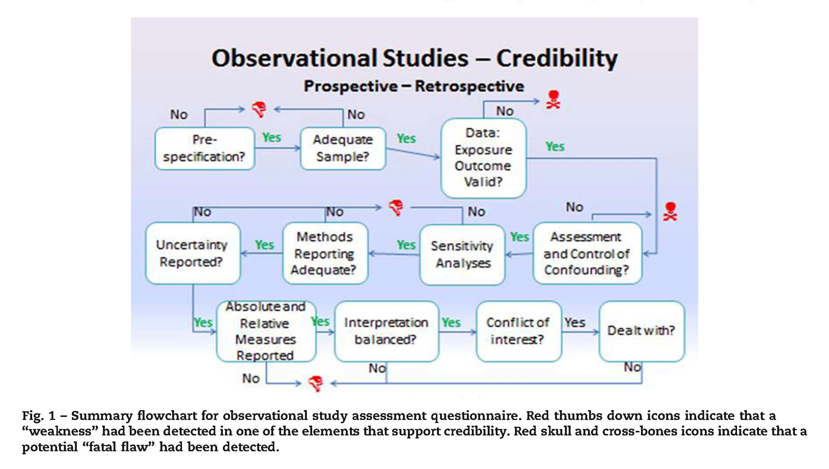
Conclusions
From: Berger et al 2014 V A L U E IN HE A L T H 1 7 ( 2 0 1 4 ) 1 4 3 – 1 5 6
19

Slide 20
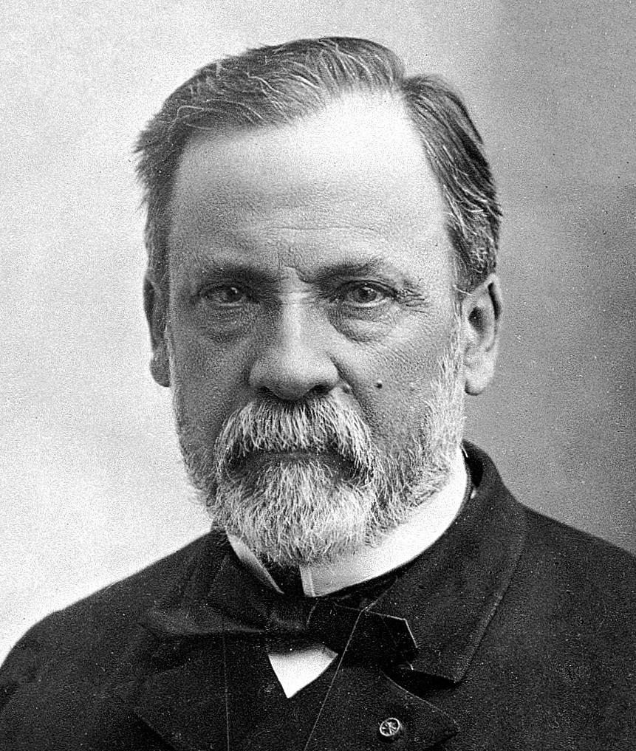
Any Questions?
In the field of observation, chance favors only the prepared mind.
Louis Pasteur, lecture 1854
French biologist & bacteriologist (1822 - 1895)

