Slide 1
Meeting local HTA requirements
Challenges for the Pharma HTA Statistician
Marie-Ange PAGET
Project Statistician – Lilly France
EFSPI meeting
Generating evidence for Health Technology Assessment
September 25th, 2014

Slide 2
Disclaimer
The views expressed herein represent those of the presenter and do not necessarily represent the views or practices of Eli Lilly

Slide 3
Agenda
Introduction
HTA/reimbursement activities for the statistician
The context: local HTA Authorities
Meeting local needs
Conclusion

Slide 4
Introduction

Slide 5
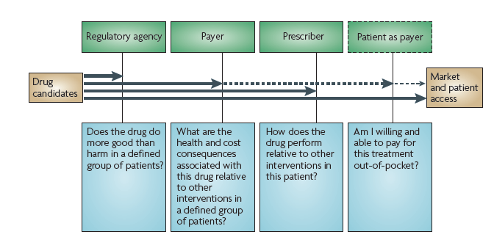
Decision-makers on the road to market access (Eichler, 2010)

Slide 6
HTA/reimbursement activities for the statistician

Slide 7
HTA/reimbursement tasks for Stats
1. Clinical development input
Design
Comparator
  Inclusion & exclusion criteria
  Outcome
  Subgroup
  QoL /resource use /cost
Interpretation and summary of all RCTs results
2. Observational Research
Before HTA submission
Generalizability of Phase III results
Understanding the burden of disease
Post-registration commitment
What are the
health and cost
consequences
associated with
this drug relative
to other
interventions in
a defined group
of patients?
3. Indirect comparisons
Systematic literature search
Data extraction
Meta-analysis
Indirect comparisons
Network Meta-Analyses
4. Economic modelling input
Disease modelling
Extrapolation of results beyond RCT duration
Utilities, EQ-5D mapping
Parameter input
Cost data

Slide 8
The context

Slide 9

HTA/reimbursement in Europe: the context
HTA / reimbursement decision is local
HTA / reimbursement requirements are local
  Formats: NICE template, SMC template, HAS template, German template,…
  Guidelines: NICE 2013 method guide, Technical Support Documents (NICE), IQWIG methodological guide,…
In a changing environment
  Germany: AMNOG came into January 2011
  France: Economic dossier since October 2013 (if requested ASMR 1-3)
  UK: elements of VBP were implemented in 2014
with a will to harmonize
    EUnetHTA early dialogues
    9 EUnetHTA guidelines
… but not yet harmonized

Slide 10
Different views from HTA bodies?
Comparator:
  Standard of care, may include off-label use
Methods:
  Indirect comparisons
  Presentation of the data
Dossier templates
Language
A comparison of National Guidelines for Network Meta-Analyses. Lows, 2014

Slide 11
Meeting the local needs

Slide 12
Content of the HTA/reimbursement dossier
Global dossier vs affiliate dossiers
  Addressing all needs?
  Addressing the first HTA submission?
  Addressing one specific submission?
Presenting clinical data
  Format with tables
  Language
Be clear on what we plan, what we don’t plan to do and the corresponding consequences
Pick and choose format
Invest in writing

Slide 13
Subgroups
Pre-planned subgroup analyses
Guidelines interpretation
Build your network

Slide 14
Indirect comparison: SR, MA, IC, NMA
Updates
Systematic Literature Search – Data extraction
Comparator
  May be different from one country to another
  Off-label use data may come from non-RCT
    Methods:
Bayesian vs Frequentist
  Must be strong if there is clinical or technical reasons not to run an indirect comparison
Set up the analyses to allow other indirect comparisons
EUnetHTA: #9 Preference should be given to the most transparent method
EUnetHTA: #2 …only comparable studies should be combined

Slide 15
Observational research
Understanding the local health care system and the different databases (often secondary databases)
Post-registration local needs and RMP need
Important to have consistency across different studies
Needs good local contacts
Important to have high levels of TA / product knowledge
Needs good cross-functional contacts

Slide 16
Conclusion
Stay consistent and scientifically sound
Keep the methods simple if possible but be mindful of what is happening
Be transparent
  Justify your choice, explain and invest in writing
Optimize resources so that most of the needs (or the most important ones) are fulfilled
Challenging, ever-changing environment
Methods are important but …
  soft skills are key such as working relationship, writing skills, and business understanding

Slide 17
Questions?

Slide 18
References
Eichler H, Bloechl-Daum B, Abadie E, Barnett D, König F and Pearson S. Relative efficacy of drugs: an emerging issue between regulatory agencies and third-party payers. Nature reviews Drug Discovery Volume 9 April 2010: 277-291
Laws A, Kendall R, Hawkins N. A comparison of National Guidelines for Network Meta-Analysis. Value in health 17 (2014) 642-654

