Slide 1
Early Dialogue with Health Technology Assessment (HTA) Agencies
Chrissie Fletcher Amgen Ltd
HTA 1-day scientific meeting
25th Sept 2014 Bayer, Berlin

Slide 2
Disclaimer (Chrissie Fletcher)
The views expressed herein represent those of the presenter and do not necessarily represent the views or practices of Amgen or the views of the general Pharmaceutical Industry.

Slide 3
Outline
Why have early dialogue with HTA agencies?
How and when to seek scientific advice in drug development
EMA-HTA workshop on early dialogue
Experiences & lessons learnt
  Industry (EFPIA)
  Regulators
Draft EMA-HTA parallel scientific process guidance
Role of the Pharma statistician in early dialogue
Early dialogue experience
Conclusions
EMA European Medicines Agency
EFPIA European Federation of Pharmaceutical Industries and Associations

Slide 4
Why have early dialogue with HTA agencies?
Patients want it – EMA approved medicines are not always reimbursed or used as expected due to HTA requirements not being met
EU Commission wants it – enables all stakeholders to discuss development plans so they can both use data generated for their decision making
Increases collaborations between regulatory and HTA agencies – understand the different perspectives
Benefits Industry – understand the HTA requirements and minimise divergent data requirements

Slide 5
How to seek parallel scientific advice in drug development
National
HTA
Agencies
EUnetHTA
EMA-HTA
EUnetHTA European network of HTA agencies

Slide 6
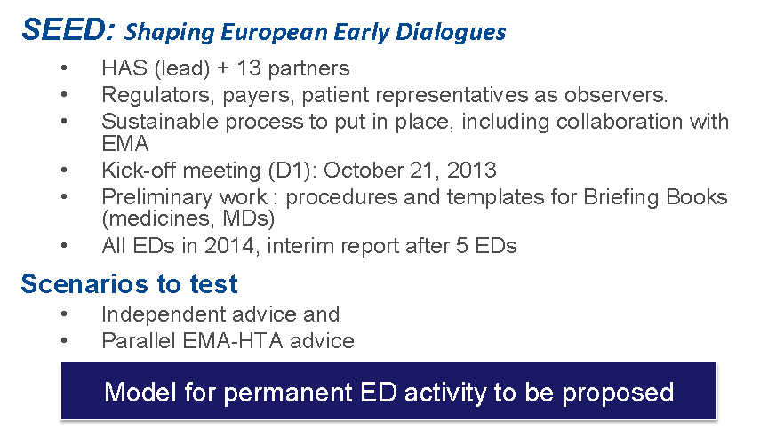
Shaping European Early Dialogues (SEED)
http://www.earlydialogues.eu/has/

Slide 7
When to seek parallel scientific advice in drug development
Pre-Phase 3 Design
Post-Phase 3 Design
Pre-Phase 3 Design HTA Engagement¹
Joint Pre-P3 Design Regulatory and HTA Engagement
Post-Phase 3 Design HTA Engagement
  Timing: P1 or P2 are underway, and prior to finalization of design of P2 / P3 program
  Timing: Often after P3 data is available, and prior to preparation for the local submission
vs.
  Primary objective: inform the design of Phase 3 trial and other data generation plans
  Primary objective: test and refine compound positioning to inform launch strategy and identify further evidence needs
vs.
Note: ¹Can take place in parallel to Regulatory Scientific Advice process

Slide 8

Well attended EMA-HTA parallel scientific advice workshop in Nov 2013!
~ 300 attendees
Wide variety of stakeholders
  Regulators, payers, patients, academics, Industry
Audience split over 2 floors at EMA
Presentations/updates in the morning followed by break-out groups in the afternoon
Useful sharing of experiences
http://www.ema.europa.eu/docs/en_GB/document_library/Report/2014/05/WC500166228.pdf

Slide 9
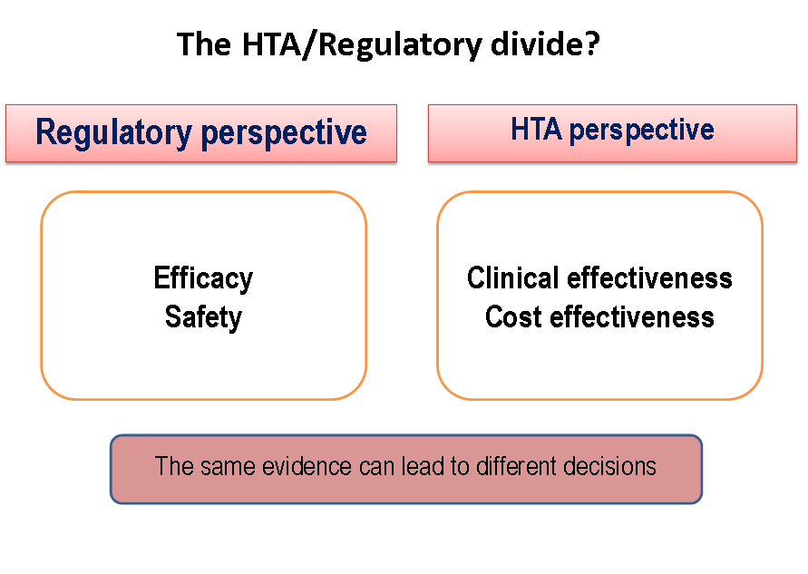
The HTA View

Slide 10
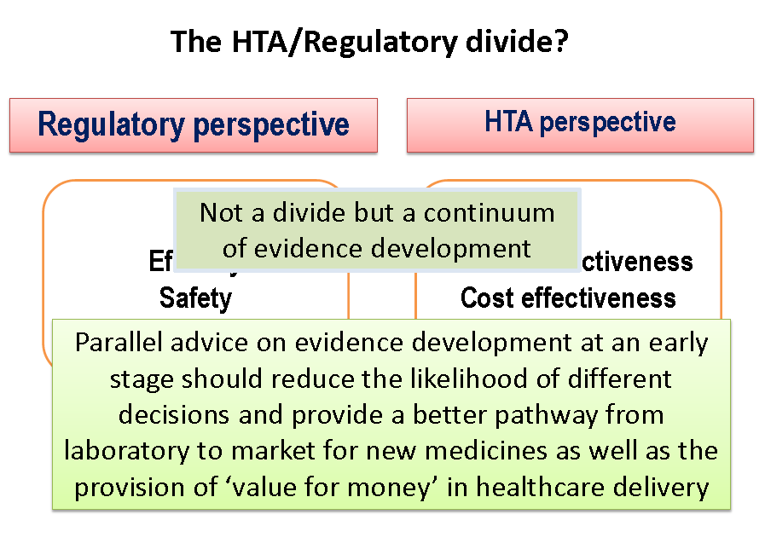

Slide 11
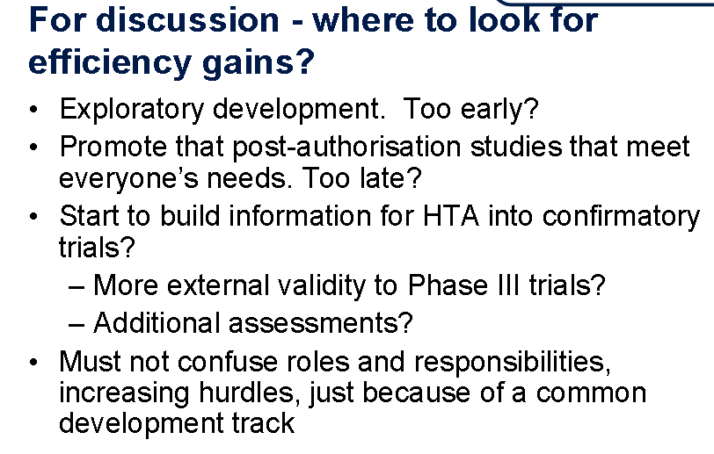
Regulatory View

Slide 12
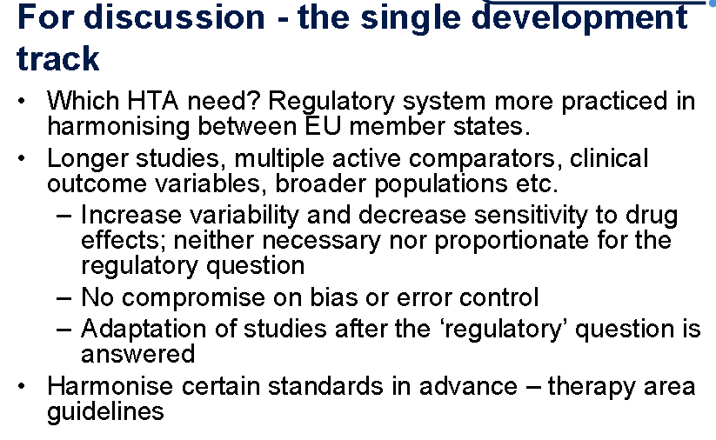
Regulatory View (cont)

Slide 13
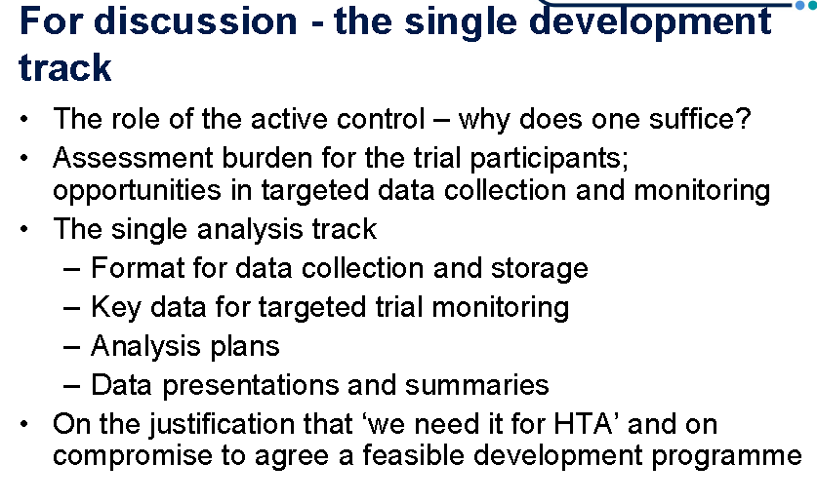
Regulatory View (cont.)

Slide 14
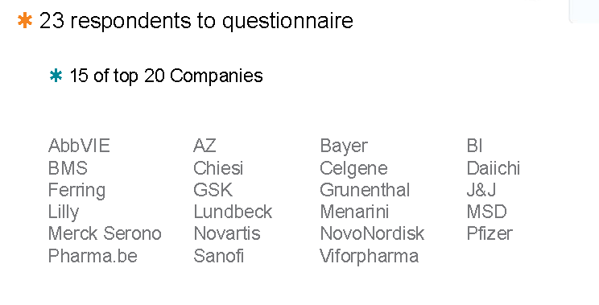
Experiences and lessons learnt - EFPIA survey
EFPIA survey:
http://www.ema.europa.eu/docs/en_GB/document_library/Presentation/2013/11/WC500155674.pdf

Slide 15
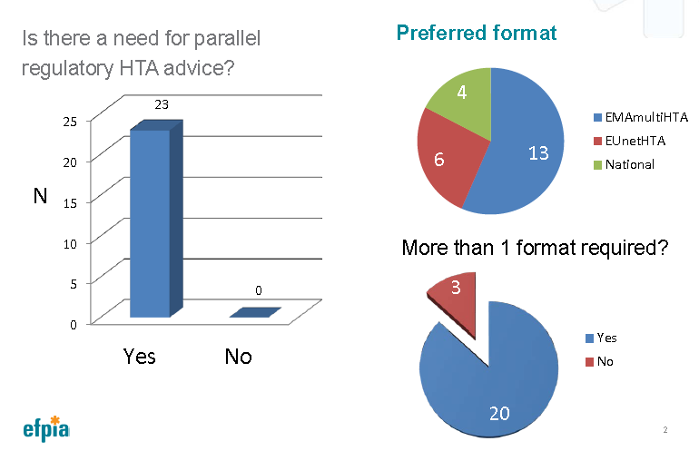
Industry demand for early dialogue is high

Slide 16
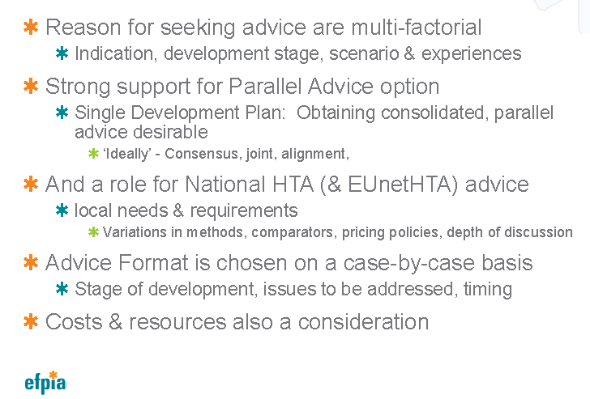
What advice is being sought?

Slide 17
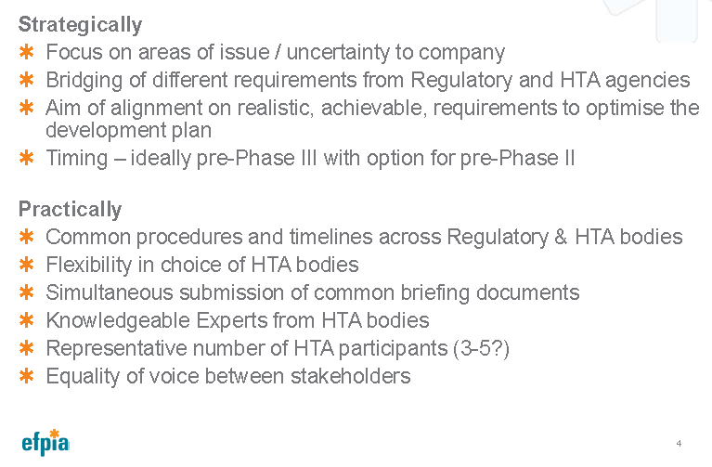
Industry requirements for optimising parallel scientific advice

Slide 18
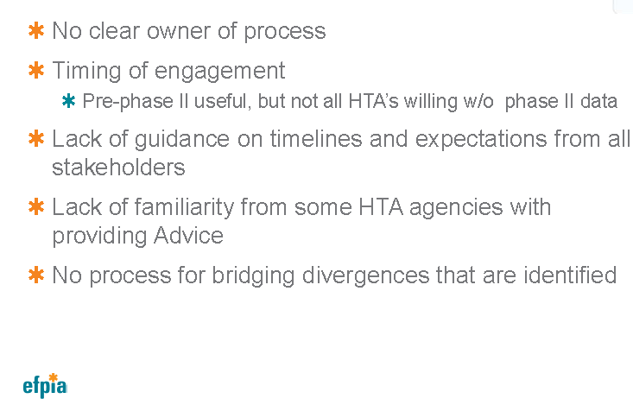
Current challenges

Slide 19
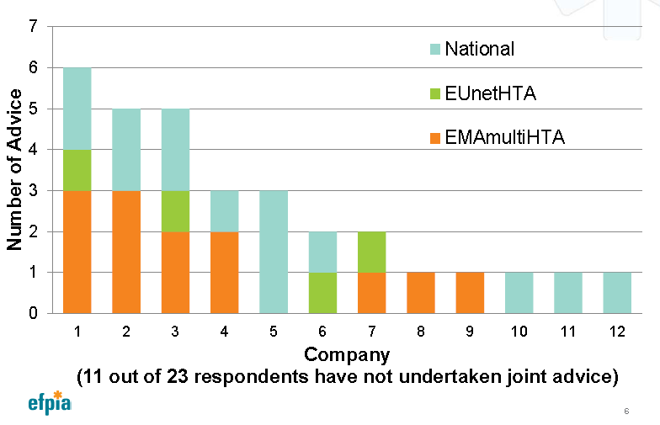
Industry experience of different approaches for early dialogue

Slide 20
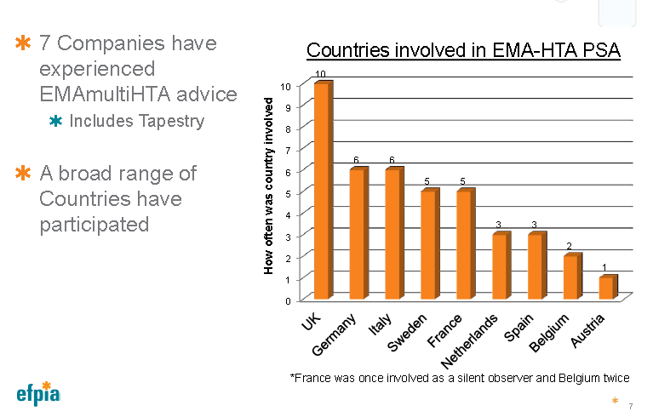
Industry experience of multiple HTA early dialogue

Slide 21
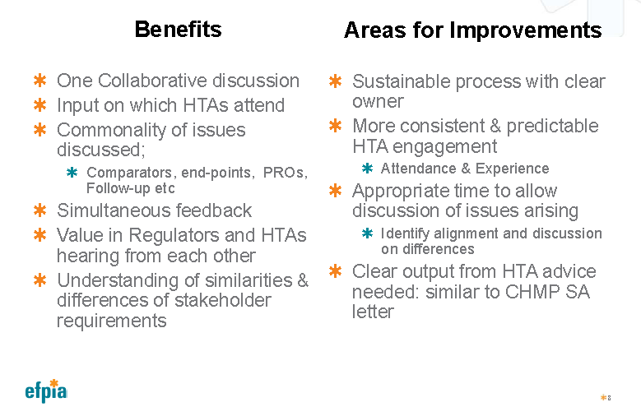
Industry considerations of EMA-HTA parallel advice

Slide 22
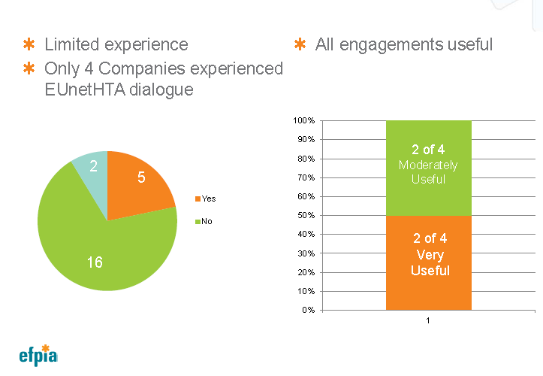
Industry experience of EUnetHTA early dialogue

Slide 23
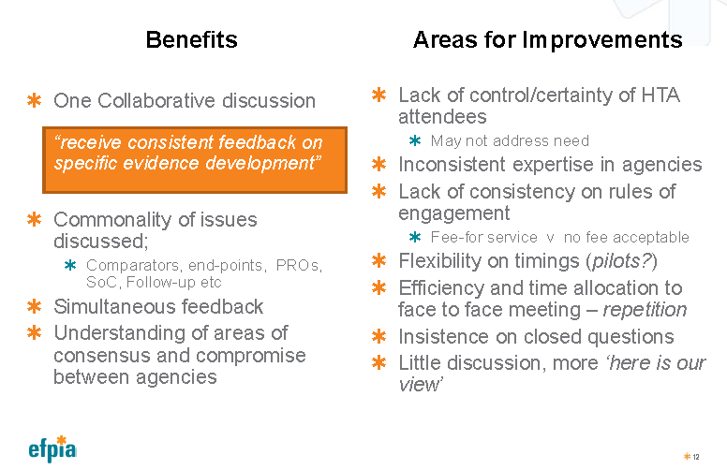
Industry consideration of EUnetHTA early dialogues

Slide 24
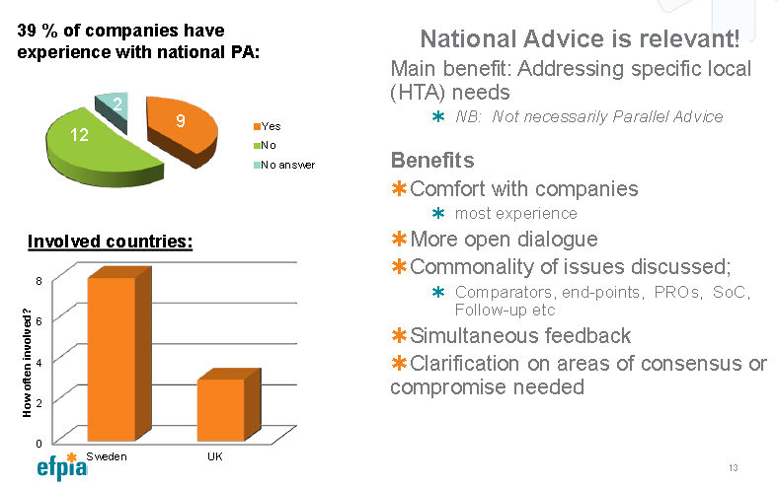
National HTA parallel advice

Slide 25
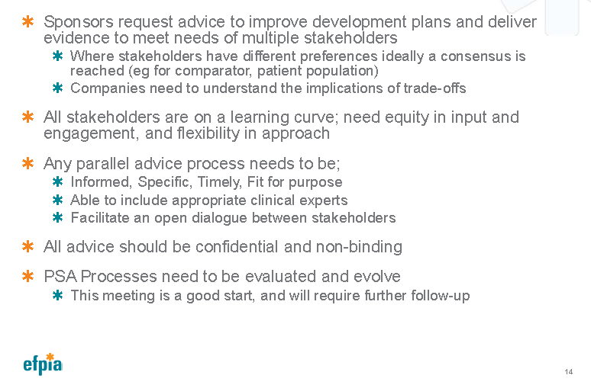
Industry summary of early dialogue

Slide 26
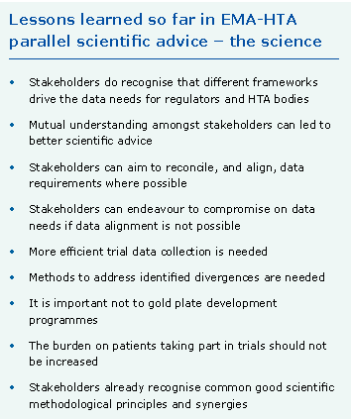
Regulators lessons learnt - science
26

Slide 27
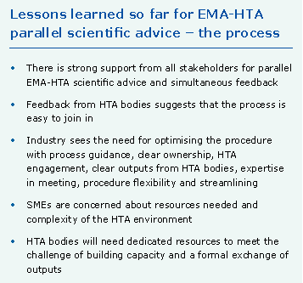
Regulators lessons learnt - process

Slide 28
Draft EMA-HTA process guideline for parallel scientific advice - principles
Continue as pilot process
Best practice highlights ideal timelines and actions
Parallel scientific advice is a multi-stakeholder procedure – communication, understanding, roles and ownership of actions is key
Each stakeholder respects roles and responsibilities of all stakeholders
Process is confidential
http://www.ema.europa.eu/docs/en_GB/document_library/Regulatory_and_procedural_guideline/2014/05/WC500166226.pdf

Slide 29
Draft EMA-HTA process guideline for parallel scientific advice - process
1
Pre-notification phase
Letter of intent
Occurs 4-6 months before face to face meeting
Applicant identifies HTA bodies (HTABs)
Complete briefing book (template)
2
Pre-validation phase
Option for teleconference
Clarifications can be via email
3
Meeting phase
4
Advice
5
Follow up

Slide 30
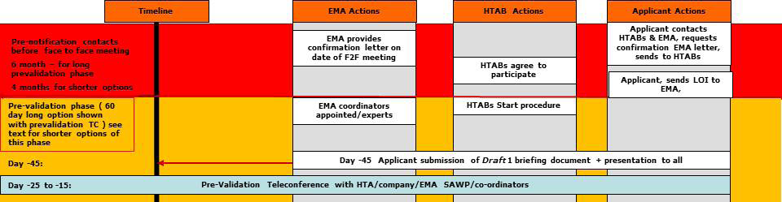
Draft process overview
Timelines for
  EMA actions
  HTA body actions
  Applicant actions
  … see draft guideline for full timeline and all actions

Slide 31
Role of Pharma Statistician in early dialogue
Briefing document preparation
  How will the trial evidence support the product value proposition?
  Summarise pooled/meta-analyses conducted and planed RCTs
  Evidence synthesis approaches for the economic evaluation
  Identify what important design or analysis questions to ask and contribute to company position
  Be aware of relevant regulatory and HTA agency methods guidelines
Participate in pre-validation teleconferences and response to questions
Attend early dialogue meetings where key statistical questions are being discussed
Contribute to summarising the meeting minutes (applicant)
Follow up on advice received
  How can the feedback be incorporated into the drug development strategy?

Slide 32
EUnetHTA guidelines for rapid effectiveness assessment (REA) of pharmaceuticals
Endpoints
Clinical endpoints
Composite endpoints
Surrogate endpoints
Safety
Health-related quality of life
Comparators and comparisons
Criteria for the choice of the most appropriate comparator(s)
Direct and indirect comparison
Levels of evidence
Internal validity
Applicability of evidence in the context of a relative effectiveness assessment

Slide 33
EUnetHTA early dialogue experience
Marie-Ange Paget, Lilly France
Pilot
Pre-phase III design
Questions on
  Phase III RCT design
  Economic modelling
6 different HTA agencies + EMA as observer

Slide 34
EUnetHTA early dialogue experience
Marie-Ange Paget, Lilly France
A great learning opportunity to understand
  the difference between HTA & regulatory views
    on RCT design
      comparator, endpoints, study duration
  the difference between HTA Authorities
  the product & therapeutic area landscape
Experience of preparing for EUnetHTA early dialogue was very positive

Slide 35
Conclusions
Early dialogue enables multi-stakeholders to discuss drug development programs
Early dialogue increases collaboration between stakeholders and sharing different perspectives
Early dialogue optimises evidence generation plans to accommodate different stakeholder requirements
Cross-functional engagement is key for early dialogue success
Current pilots will help to shape a sustainable early dialogue process

Slide 36
References
Shaping European Early Dialogue (SEED): http://www.earlydialogues.eu/has/
EMA-HTA early dialogue workshop report: http://www.ema.europa.eu/docs/en_GB/document_library/Report/2014/05/WC500166228.pdf
EFPIA survey on early dialogue experiences: http://www.ema.europa.eu/docs/en_GB/document_library/Presentation/2013/11/WC500155674.pdf
Draft EMA-HTA parallel scientific advice process guideline: http://www.ema.europa.eu/docs/en_GB/document_library/Regulatory_and_procedural_guideline/2014/05/WC500166226.pdf
EUnetHTA Guidelines for Rapid Relative Effectiveness Assessment of Pharmaceuticals: http://www.eunethta.eu/eunethta-guidelines

