Slide 1

Cardiovascular medicine: approaches to the use of early biomarker response to identify a patient subgroup with enhanced therapeutic benefit
Björn Bornkamp, Georgina Bermann

Slide 2
Contents
Background
Estimating the treatment difference of interest
Simulations
based on https://doi.org/10.1080/19466315.2019.1575280

Slide 3
Background: the CANTOS trial
CANTOS trial
  Tested whether reducing inflammation with canakinumab leads to reduction in the risk of CV events
  Canakinumab blocks Interleukin-1β (IL-1β) a cytokine that modulates inflammatory response
    The downstream marker of inflammatory risk and also of treatment activity was high-sensitivity C-Reactive Protein (hsCRP)
    Observational data establish that it is prognostic of cardiovascular risk
Population:
  previous myocardial infarction and hsCRP > 2 mg per liter
Treatment
  Three dosing regimens vs placebo
    50mg, 150mg, 300mg every 4 weeks (+ loading for the 300mg group)
Primary outcome: Time to first major adverse cardiovascular events (MACE)
    cardiovascular death, nonfatal myocardial infarction, or nonfatal stroke
Results:
  Only 150mg significant after adjusting for multiplicity with a hazard ratio of 0.85

Slide 4
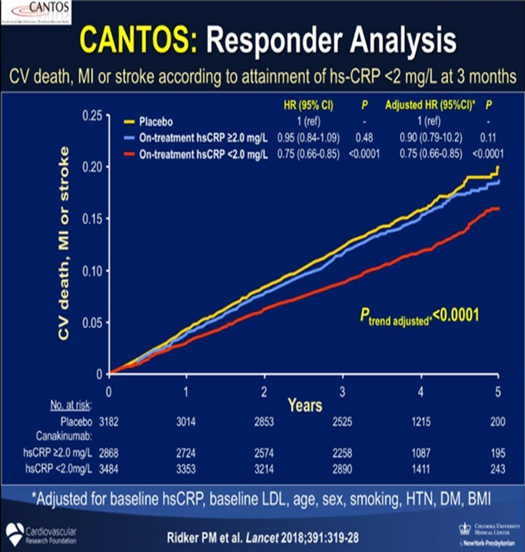
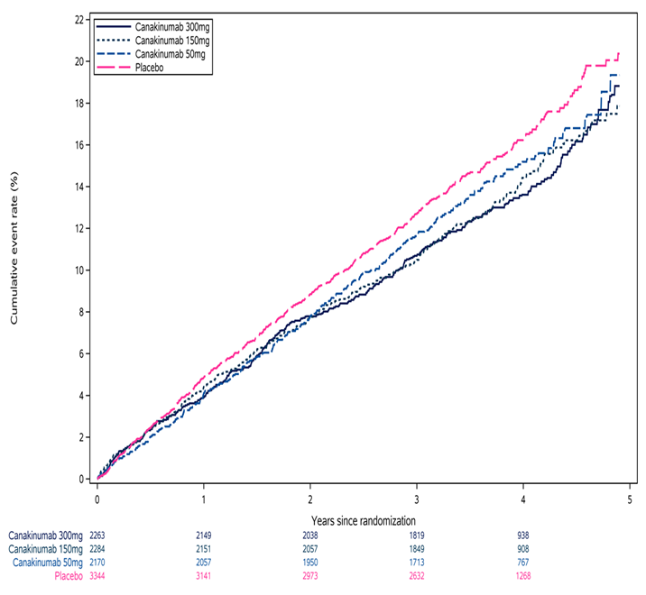
Responder subgroup in the CANTOS trial
It suggested a larger benefit in this subpopulation than in the overall trial population
The comparison implemented compared responders pooling all 3 canakinumab groups, to all placebo regardless of their month 3 hsCRP levels

Slide 5
What is the estimand that captures the effect of treatment?
Estimand: Treatment effect on MACE in the population of patients that would at month 3 reach hsCRP < 2.0 mg/L if assigned to treatment
Attainment of hsCRP levels < 2 mg/L on active treatment is an event arising post-randomization
Identification of this estimand requires strong assumptions in a parallel groups trial
  Not immediately clear how survival for treatment threshold achievers would have been if treated with placebo
  & vice versa which patients on placebo would have achieved the threshold if they had received treatment

Slide 6
Principal stratification estimand
 | Placebo B(0) = 1 hsCRP<2mg/dL | Placebo B(0) = 0 hsCRP≥2mg/dL
Treatment B(1) = 1 hsCRP<2mg/dL
Treatment B(1) = 0 hsCRP≥2mg/dL
Z - indicator of treatment assignment (0: Placebo, 1:Active)
B(z) -potential biomarker outcome for treatment Z=z
T(z) –Survival outcome on treatment z
The outcome is survival with respect to MACE
  Subpopulation of interest
    Patients with B(1) = 1 (threshold achievers on treatment)
  Quantities of interest to estimate
    Survival for treatment threshold achievers on treatment
    P(T(1) > t | B(1) = 1)
    Survival for treatment threshold achievers on placebo
    P(T(0) > t | B(1) = 1)

Slide 7





Potential outcomes
Each patient has 2 potential outcomes related to treatment assignment
  Biomarker levels on treatment, B(1) and on placebo B(0)
  Survival on treatment, T(1), and survival on placebo T(0)
In a parallel arm clinical trial only one of these combinations can be observed
 | B(0) = 1 | B(0) = 0
B(1) = 1
B(1) = 0 | T(1) T(0) | T(1) T(0)
T(1) T(0)
T(1) T(0)

Slide 8




Identification and estimation:
P(T(0) > t | B(1) = 1)
Requires additional assumptions: T(0) $⊥$ B(1) | X
We utilize covariates X predictive of T(0) and B(1)
$$\text{P}\text{(}\text{T}\text{(0) > }\text{t}\text{ | }\text{B}\text{(1) = 1)}=∫ \text{P}\text{(}\text{T}\text{(0) > }\text{t}\text{ | }\text{B}\text{(1) = 1, }\text{X}\text{) }\text{p}\text{(}\text{X}\text{ | }\text{B}\text{(1) = 1) }\text{dX}$$
$$=∫\text{P}\text{(}\text{T}\text{(0) > }\text{t}\text{ | }\text{X}\text{)} \text{p}\text{(}\text{X}\text{ | }\text{B}\text{(1) = 1) }\text{dX}$$
Bby conditional independence
Obtain averaged placebo survival of treatment responders using their covariates
$\text{P}\text{(}\text{T}\text{(0) > }\text{t}\text{ | }\text{X}\text{)}$
Predict placebo survival for responders on treatment

Slide 9


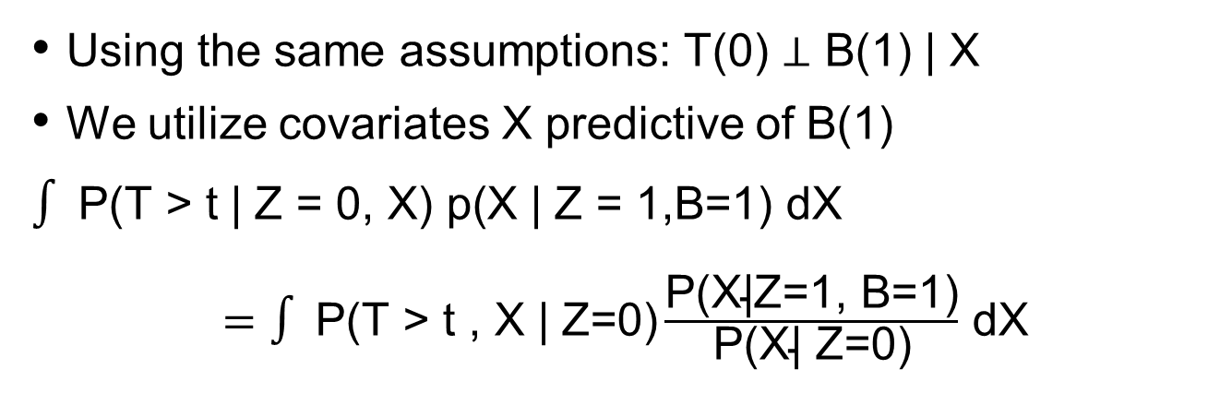
Identification and estimation:
P(T(0) > t | B(1) = 1)
Using the same assumptions: T(0) $⊥$ B(1) | X
We utilize covariates X predictive of B(1)
$$∫ \text{P}\text{(}\text{T}\text{ > }\text{t}\text{ | }\text{Z}\text{ = }\text{0}\text{, }\text{X}\text{) }\text{p}\text{(}\text{X}\text{ | }\text{Z}\text{ = 1}\text{,}\text{B}\text{=1}\text{) }\text{dX}$$
$=∫ \text{P}\text{(}\text{T}\text{ > }\text{t} \text{,} \text{X} \text{|} \text{Z}\text{=0)}\frac{\text{P}\text{(}\text{X}\text{|}\text{Z}\text{=1, }\text{B}\text{=1)}}{\text{P}\text{(}\text{X}\text{|} \text{Z}\text{=0)}}$ dX
Compare to observed placebo survival weighting placebo patients with
P(B=1|Z=1,X)
Either weighted survival or weighted regression for survival outcomes

Slide 10
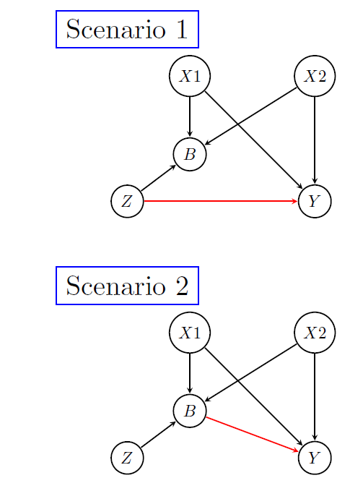
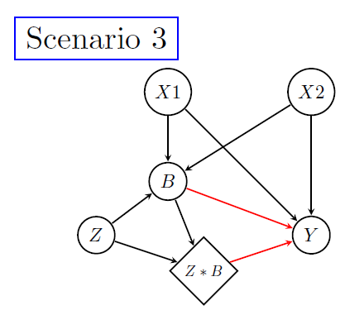
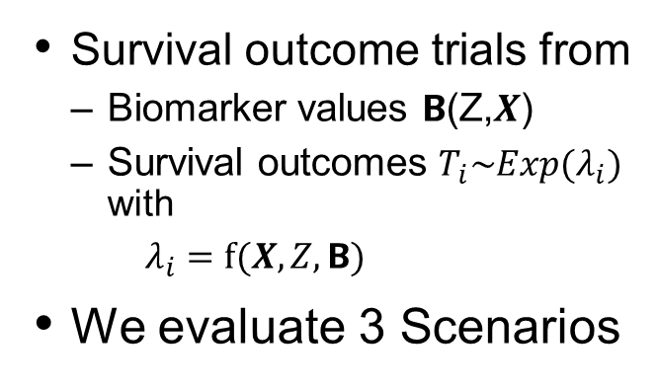
Simulation experiment to evaluate performance
Survival outcome trials from
  Biomarker values $Β$(Z,$X$)
  Survival outcomes $T_{i}\sim Exp(λ_{i})$ with
      $λ_{i}=f⁡(X,Z,Β)$
We evaluate 3 Scenarios

Slide 11
Issue of the measure for survival outcomes
The simulations evaluate the difference in restricted mean survival time (RMST)
Reluctance to use the hazard ratio was due to
  non-collapsibility
  lack of causal interpretation specifically of the estimate from Cox regression even in a randomized clinical trial (Aalen et al 2015).
However, we mention that
  if the cumulative hazard functions are approximately linear, a simple exponential model could be derived to estimate the hazard, and calculate the hazard ratio as the ratio of the hazards.
Main difference:
  A difference in survival can be estimated non-parametrically (e.g. using the difference in RMST)
  The hazard rate requires additional modelling assumptions to obtain a single estimate that represents the average hazard rate used to calculate the ratio between treatments

Slide 12
Performance evaluation
Comparison of survival:
    Predicted Placebo Response (PPR) and Weight Placebo Patients (WPP) difference in restricted mean survival time at a pre-specified time point
Comparison based on the hazard rates:
  Predicted Placebo (PP)
    Same as survival for PPR above. We use a nonlinear regression fit to the survival functions that follows an exponential or Weibull parametrization, and fitting a weighted linear regression model to the cumulative survival function
  Weight Placebo (WP)
    With weighted Cox regression including treatment only, and X1 and X2 (DR)
We also compare with 2 “naive“ approaches:
    NAIVE_THRES- compares to placebo patients reaching the threshold (on placebo)
    NAIVE_FULLPBO- compares to all placebo patients regardless of whether they would have been responders if given treatment or not

Slide 13
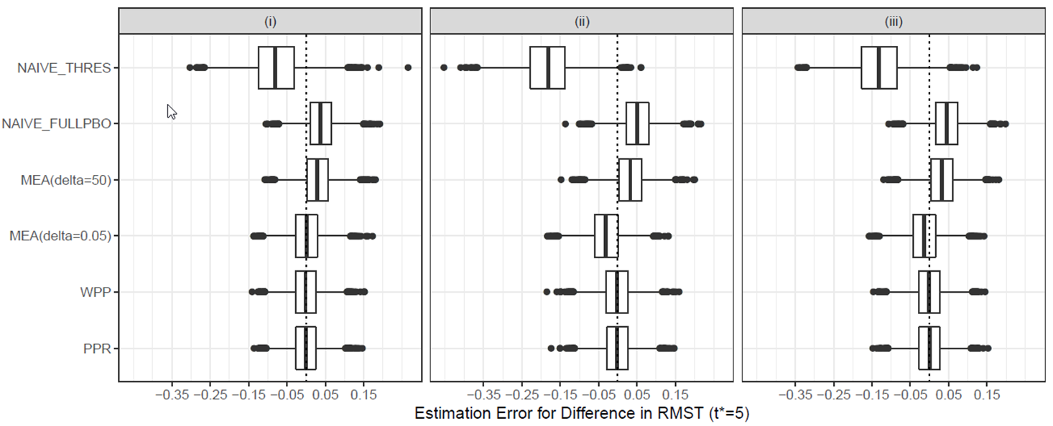
Results: survival difference scale
Only main effect of Z
(ii) Only main effect of Β
(iii) Main effect of Β and Z* Β

Slide 14
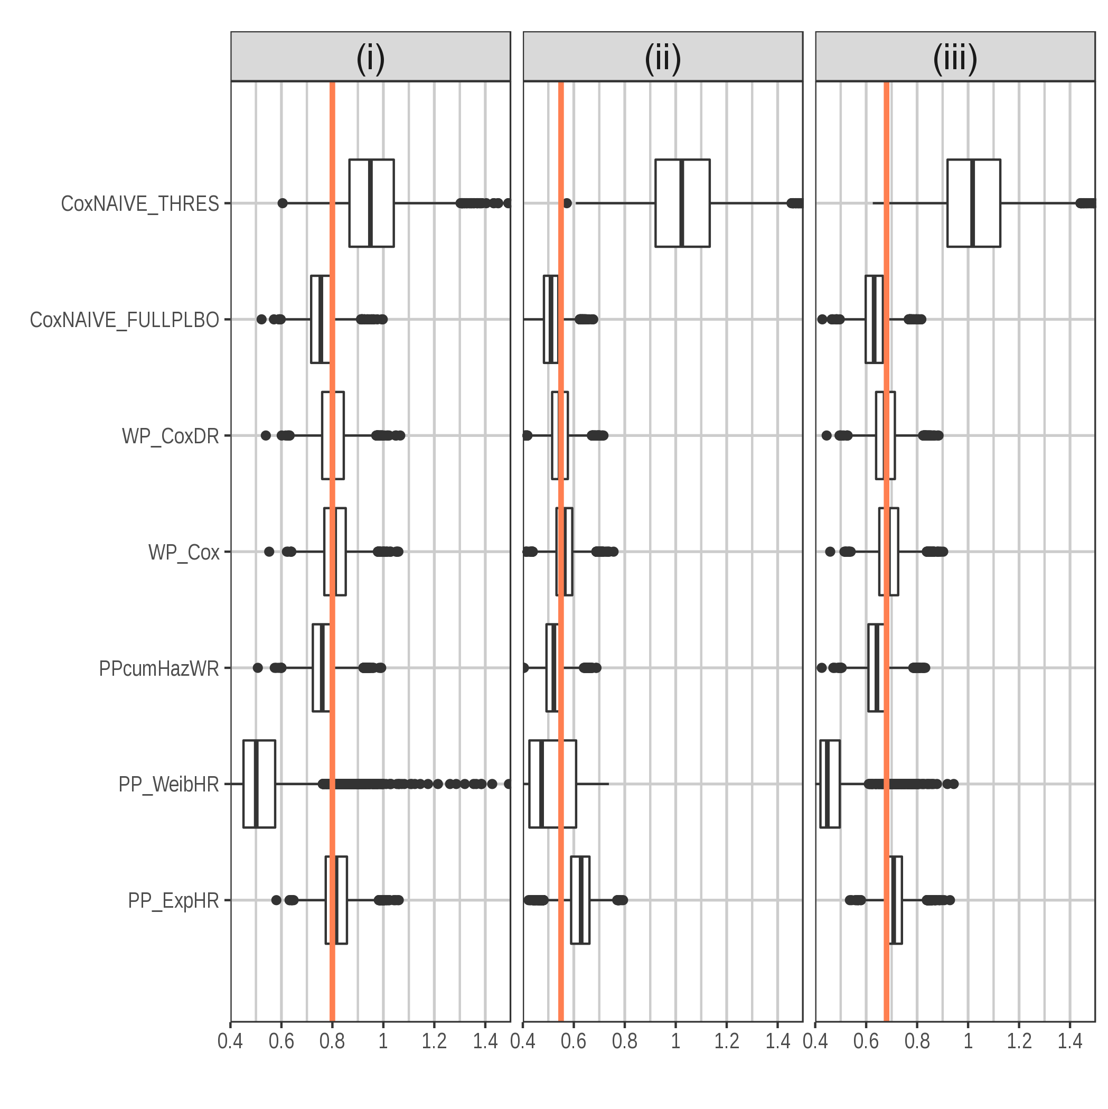
Results: hazard ratio scale

Slide 15
Summary
These are approaches to derive the magnitude of treatment benefit in a patient subpopulation defined by an early biomarker response
  They are not meant as mediation analysis
  They do not fall in the surrogacy field
  We do not account for inter-current events. Their treatment requires additional assumptions.
  We keep survival risk between treatments equal to risk at the time of randomization assuming all patients have biomarker measurements
Survival difference scale: both approaches perform well regardless of the path through which treatment impacts survival
Hazard ratio scale: only the weighted placebo applied to Cox regression including covariates performs well regardless of treatment path

Slide 16
Is this useful for cardiovascular drug development?
An early response to treatment can be used for treatment optimization strategies or treatment selection
  This framework cannot replace a randomized comparison, but may be useful for planning future targeted randomized trials
Cardiovascular outcome trials build on the premise of homogeneous patient responses
  but the long treatment horizon with competing events dilutes treatment impact in some patient segments
  This causal inference framework can enhance understanding of patient responses
  Protocol defined follow up treatment strategies might be a way of optimizing the conduct of these trials

