Slide 1
Difficulties with network meta-analysis when starting to use PD-L1 thresholds
Notes:
Dear all,
I am Mario Ouwnes, senior statistical science direct within AZ working in the group SIRE (Statistical Innovation Reimbursemen Evidence)
I would like to talk about difficulties with network meta analysis when starting to use PD-L1 thresholds.

Slide 2

Disclaimer
The views and opinions expressed in the following
PowerPoint slides are those of the individual presenter
and should not be attributed to AstraZeneca.
Notes:
I have a disclaimer to say that I will present my opinion, rather than the opinion of AZ.

Slide 3
Summary presentation
Objective: To compare nivolumab with pembrolizumab within NSCLC 2nd line or later
PD-L1 is an important effect modifier for immuno oncology treatments in NSCLC
As such, the Network Meta Analysis of Kim et al (2018) compared nivolumab with pembrolizumab per PD-L1 level
However, Kim et al (2018) used hazard ratios where the proportional hazards assumption is violated
In this presentation, non-proportionality is accounted for by the use of splines
Results of the spline approach will be presented and seem to contradict conclusions of Kim et al (2018)
Notes:
I would like to start with a summary of my presentation.

Slide 4
Lung cancer (NSCLC) and its treatment
Lung cancer (NSCLC) is the leading cause of cancer death
Docetaxel is the standard of care for second-line or third-line NSCLC treatment
PD-1 and PD-L1 inhibitors (Immuno Oncology treatments) have become available or are under investigation offering improved efficacy

Slide 5
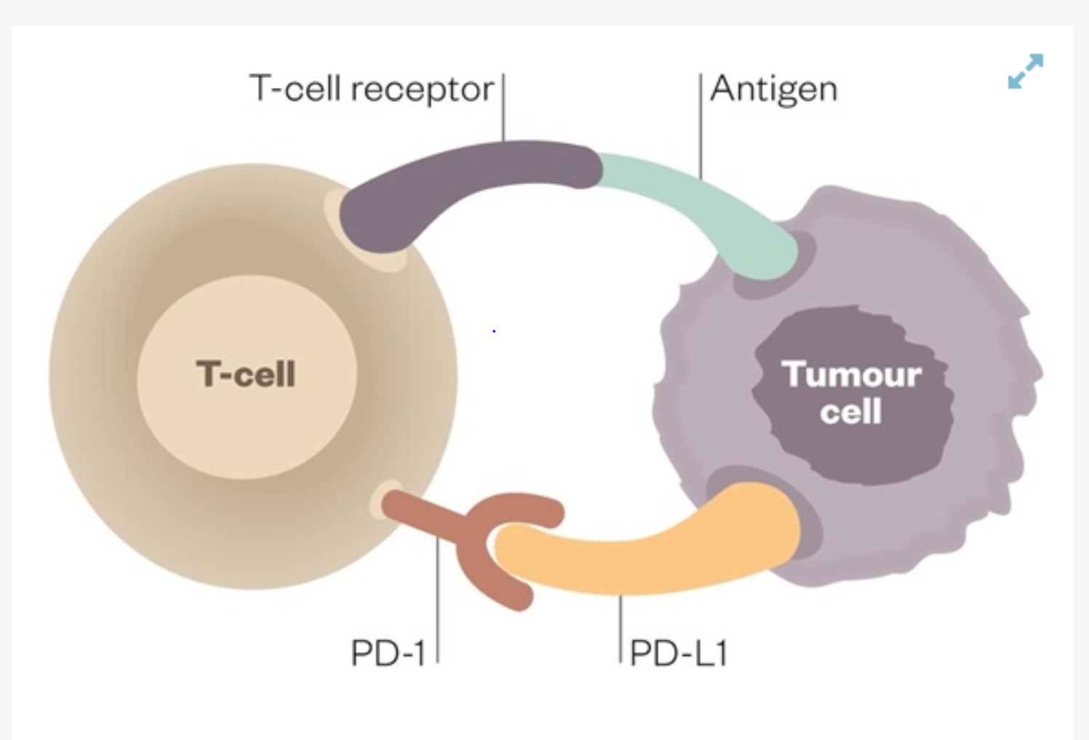
Immuno-oncology: PD-1 and PD-L1 inhibitors
PD1 and PD-L1 inhibitors:
Different mode of Action to docetaxel
Docetaxel
Docetaxel blocks the growth of the cancer by stopping the cancer cells from dividing and multiplying.
PD1 and PD-L1 inhibitors
PD1 and PD-L1 inhibitors block response of the tumour cells generated via PD-L1 or PD-1 to T cells and
prevent against inactivation of T-cells, which themselves are scanning the body for abnormalities and infections

Slide 6
NMA: 2018 scientific report comparing atezolizumab, nivolumab and pembrolizumab at different PD-L1 levels
Jinchul Kim, Jinhyun Cho, Moon Hee Lee, Joo Han Lim, Relative Efficacy of Checkpoint
inhibitors for advanced NSCLC According to Programmed Death-Ligand-1 Expression: A Systematic Review and Network Meta-Analysis. Sci Rep. 2018; 8: 11738.
Objective: Network meta-analysis aimed to assess the survival benefit and
comparative efficacy of checkpoint inhibitors according to PD-L1 expression level:
<1%, 1–49%, and ≥50%.
Method: A fixed-effects Bayesian network meta-analysis (NMA) was performed to estimate
hazard ratios (HRs) for overall survival (OS) with 95% credible intervals (CrIs).
Conclusion: Atezolizumab, nivolumab, and nivolumab were the most effective agents for
second- or later-line settings in the PD-L1 < 1%, PD-L1 1–49%, and PD-L1 ≥ 50% subgroups, respectively.

Slide 7
2nd line or later nivolumab and pembrolizumab trials included in Kim et al (2018)
2nd line or later nivolumab and pembrolizumab trials included in Kim et al (2018):
Nivolumab: Checkmate 017 squamous and Checkmate 057 non squamous
Pembrolizumab: Keynote 010 79% non-squamous
Same docetaxel prescription and only ECOG 0/1 for all trials

Slide 8
PD-L1 levels
Study | N | PD-L1 inclusion | Pre-specified PD-L1 levels
CM 017 Squamous | 135 nivolumab 137 docetaxel | All comers | >=1% >=5% >=10%
CM 057 Non-squamous | 292 nivolumab 290 docetaxel | All comers | >=1% >=5% >=10%
KN 010 79% non-squamous | 345 pembro 2mg 346 pembro 10mg 343 docetaxel | >=1% | >=1% >=50%
Only for these levels, KM data are publically available

Slide 9
HR second line or later nivolumab and pembrolizumab;
PD-L1 dependency
HR 1-49%:
Nivolumab versus docetaxel
Checkmate 017: 0.75 [0.49, 1.16]
Checkmate 057: 0.77 [0.55, 1.08]
Pembrolizumab versus docetaxel
Keynote 010: 0.76 [0.64, 0.89]
Checkmate 017 Squamous showing much less change than
Checkmate 057 Non-squamous
Pembrolizumab in between with 79% non-squamous
HR 50%+
Nivolumab versus docetaxel
Checkmate 017: 0.68 [0.27, 1.66]
Checkmate 057: 0.35 [0.22, 0.55]
Pembrolizumab versus docetaxel
Keynote 010: 0.51 [0.41, 0.64]

Slide 10
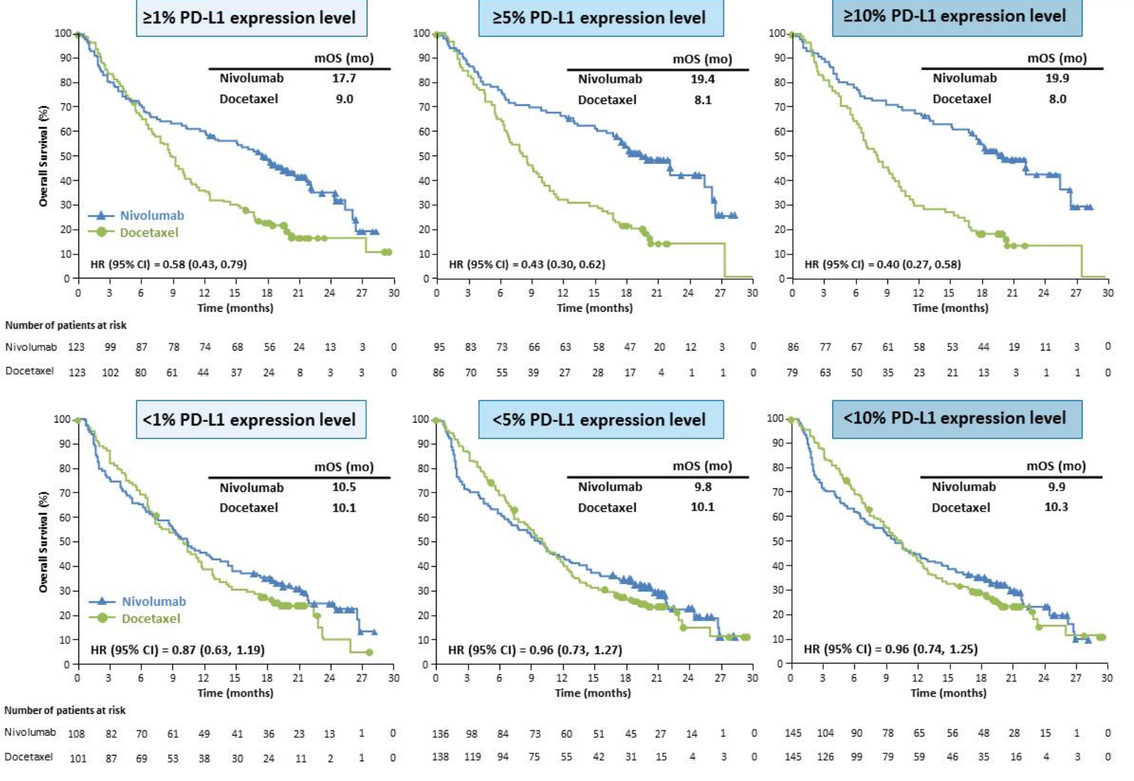
PD-L1 dependent treatment effect in Checkmate 057

Slide 11
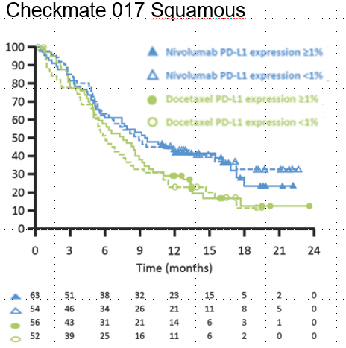
Included Kaplan Meiers Nivolumab for PD-L1 >= 1%
Checkmate 057 Non-squamous
HR >=1% 0.58 [0.43, 0.79]
Median: nivo 17.7, docetaxel 9.0
HR >=1% 0.69 [0.45, 1.10]
Median: nivo 9.3, docetaxel 7.2

Slide 12
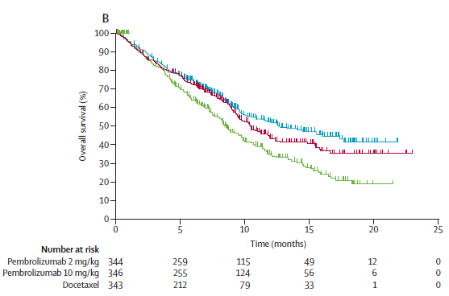

Included Kaplan Meiers Pembrolizumab for PD-L1 >= 1%
Pembrolizumab 10mg
HR >=1% 0.61 [0.49, 0.75]
Median: pembro 12.7, docetaxel 8.5
Pembrolizumab 2mg
HR >=1% 0.71 [0.58, 0.88]
Median: pembro 10.4, docetaxel 8.5

Slide 13
Kaplan Meier extraction
We extracted the KM of the previous slides based on
Guyot, Ades, Ouwens and Welton (2012) Enhanced secondary analysis of survival data: reconstructing the data from published Kaplan-Meier survival curves; BMC Medical Research Methodology 2012 12:9
And wanted to apply the approach discussed in Ouwens et al based on standard extrapolation distributions:
  Network meta‐analysis of parametric survival curves
  Ouwens, Philips, Jansen accepted by NICE and referred in TSD 14
  Res Synth Methods. 2010 Jul;1(3-4):258-71. doi: 10.1002/jrsm.25. Epub 2011 Mar 11.
  Network meta-analysis of survival data with fractional polynomials Jansen not selected as 4 out of 7 rejected by NICE
  (found in systematic review of NICE submissions)
  Stat Med. 2015 Jul 10;34(15):2294-311. doi: 10.1002/sim.6492. Epub 2015 Apr 15.

Slide 14
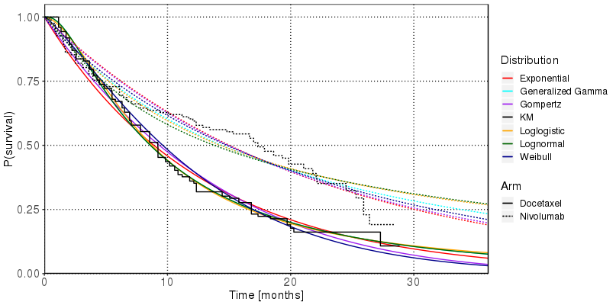
Fit of parametric distributions to Checkmate 057
Standard distributions provided a poor fit to the nivolumab data
Alternative: Splines
For the analysis:
  Arbitrarily chosen knots:
  half a year and a whole year
  Simple NMA based on inverse variance weighting of each of the coefficients
  Log(-log(S)) as survival percentage transformation

Slide 15
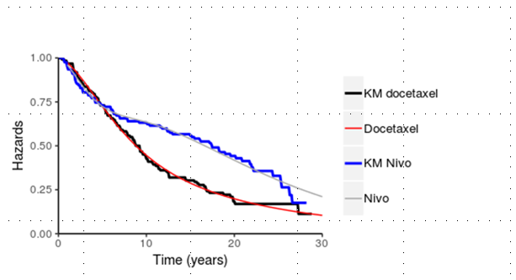
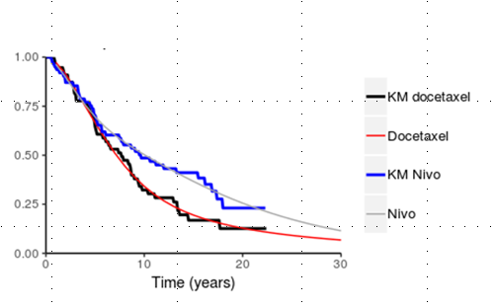
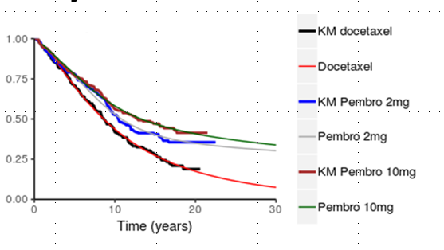
Fit of splines (PD-L1 >=1%)
Checkmate 17
Checkmate 57
Keynote 10

Slide 16
Simple NMA: Combining vectors ignoring covariance
Simple version used
(for illustrational purposes):
inverse variance per coefficient
(0.3/0.75 + 0.4/0.35)/(1/0.75 + 1/0.35) = 0.37
Adding to Keynote 10 docetaxel:
-3.23 + 0.37 = -2.86
Better version: Suzanne Freeman, James R. Carpenter: Bayesian one-step IPD network meta-analysis of time-to-event
data using Royston-Parmar models 2016

Slide 17
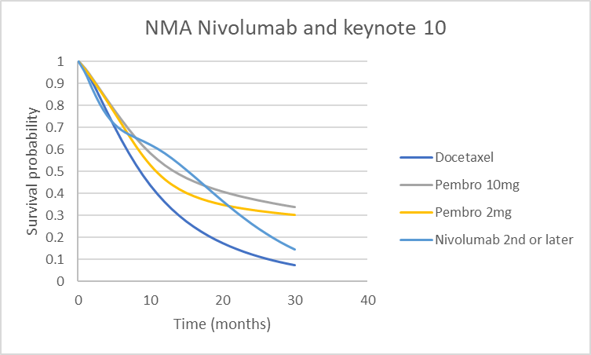
Results for PD-L1 >= 1% for 2nd line and later
Conclusion:
  Crossing curves
  In the long term, rather than nivolumab, pembrolizumab may be preferred

Slide 18
Take home message
Comparing efficacy across PD-L1 levels is important, but use of HR is questionable
Spline approaches, among others, can be used when Kaplan Meiers are presented for different PD-L1 levels
Data may not be available at a sufficient granularity to model impact of the characteristic
Sample sizes are decreased when evaluating subgroups

Slide 19
Personal opinion
In areas where biomarkers are influencing end results, we need to have consistent definitions of biomarkers and present Kaplan Meiers for all relevant categories in a consistent way across trials.
Spline approaches may be valid per category, even while the choice of number and place of knots is subjective (may require clinical validation)
However, insufficient information may be present to pool data across trials at all

Slide 20
Background slides

Slide 21
Accounting for PD-L1 level when
Individual Patient Data are available from the own trial
A few possible approaches would exist when individual patient data would be available
  PD-L1 subgroup analysis
  Estimating a PD-L1 enhancement factor from our data and applying to comparator trial in cases where equivalent PD-L1 subgroup data for the comparator are not available
  Weighting our data using the percentages in each of the categories of the comparator trial; Estimating a beta-distribution based on the percentages in the comparator trial to get a more refined impression of the distribution of PD-L1 in the comparator trial and using this beta-distribution to reweight our data
  Using PD-L1 as a covariate in our models for our own trial and validating the assumed relationship. Then using Simulated Treatment Comparison approaches to link our trial with the comparator trial (NICE TSD 18)

